Slide 1

OHSAA RECRUITING PRESENTATION,
BYLAW 4-9:
2022-23 School Year

Slide 2
Sections of Bylaw 4-9
  4-9-1:
  Definition of prospective student-athletes
  4-9-2:
  Definition of recruiting
4-9-3:
Allowable contact
  4-9-4:
  Illegal contact
  4-9-5:
  Visiting
  a school
  4-9-6:
  Admissions Office Role
  4-9-7:
  Penalties
Disclaimer: The information presented in this PPT is intended to serve as a tool to assist individuals in understanding the recruiting bylaw. All final interpretations and/or penalties are left to the sole discretion of the Executive Director's Office.

Slide 3
Bylaw 4-9-1
Definition of Prospective A student athlete
Bylaw 4-9-1 indicates that “any attempt to recruit a prospective student-athlete for athletic purposes shall be strictly prohibited.” Who is considered a “prospective student-athlete?”
  Any student in grades 9-12
  Any student in grades 7-12
  Any student in grades 6-12
  Any student in grades 5-12
  Any student in grades K-12
  The answer is B. A student is considered a prospective athlete after enrolling in the seventh grade, or the grade corresponding to the seventh grade for a student from a foreign country, regardless of whether the student is currently enrolled in a public 7th-8th grade school located within a public school district or a non-public school that is part of a non-public system.

Slide 4

Bylaw 4-9-2
What is the definition of “recruit” as outlined in
Bylaw 4-9-2?
“The term “recruit” shall mean the use of influence by any person connected or not connected with the school to secure the enrollment of a prospective student-athlete for athletic purposes.”
This prohibition of securing the enrollment of a student for athletic purposes applies to all non-school personnel too (i.e. a club coach, a fan in the community, a student from an opposing team etc.).

Slide 5
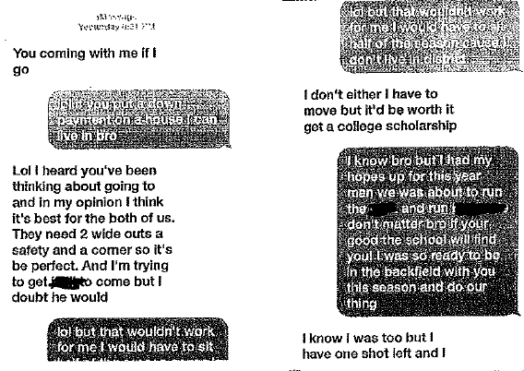
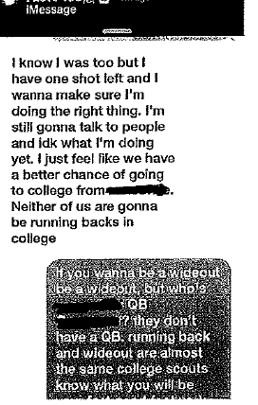
Bylaw 4-9-2 Violation
Lol but that wouldn’t work for me I would have to sit half of the season cause I don’t live in district
Lol you put a down payment on a house I can live in bro
I know bro but I had my hopes up for this year man we was about to run the ____ and run _______ don’t matter bro if your good the school will find you. I was so ready to be in the backfield with you this season and do out thing
Lol but that wouldn’t work for me I would have to sit
In this instance, the “receiving school” would not have any recruiting penalties, but if these two students transferred and the OHSAA obtained these messages, then both would be ruled ineligible for a period of time.

Slide 6
Definitions summary
4-9-1 A student is considered a prospective athlete after enrolling in the seventh grade, or the grade corresponding to the seventh grade for a student from a foreign country, irrespective of whether the student is currently enrolled in a public 7th-8th grade school located within a public school district or a non-public school that is part of a non-public system. Any attempt to recruit a prospective student-athlete for athletic purposes shall be strictly prohibited.
4-9-2 For purposes of this Bylaw Section 9, the term “recruit” shall mean the use of influence by any person connected or not connected with the school to secure the enrollment of a prospective student-athlete for athletic purposes.

Slide 7
Recruiting Bylaw 4-9-2 Exception
There are two exceptions (one for public school coaches and one for non-public school coaches) which will allow a high school coach to have athletic related contact with students in grades 7-8 to influence their enrollment at the school and not be in violation of Bylaw 4-9-2.

Slide 8
When are public high school coaches allowed to have contact with 7-8 grade students for athletic purposes? (Select all that apply; HINT: 2 correct responses).
High School coaches in a multi-HS district coaches can have contact with a 7 8 grade student who resides in that district regardless of what school the student attends (district or non district school).
High School coaches in a multi-HS district can have contact with a 7-8 grade student who attends any 7-8 grade school within the district.
High school coaches in a multi-HS district can have contact with a 7-8 grade student who attends any 7-8 grade school within the district as long as the student would be assigned to the high school where the coach or school employee works
High School coaches in a single HS district can have contact with a 7 8 grade student who resides in that district regardless of what school the student attends (district or non district school).
High School coaches in a single HS district can have contact with a 7 8 grade student who attends any 7 8 grade school within the district.
Answer: The answers are C and E.
Notes:
For purposes of this question, the same type of school is referred to the Catholic Conference of Ohio, Ohio Association of Independent Schools, Association of Christian Schools International or other category as denoted by the State Department of Education.

Slide 9
When are non-public high school coaches allowed to have contact with 7-8 grade students for athletic purposes? (Select all that apply; HINT: 2 correct responses).
Non-public high school coaches can have contact with any 7-8 grade student currently enrolled in a non-public school of the same type if the boundaries of that non-public school system are clearly defined and on file with the OHSAA and the contact is restricted to students enrolled within that defined boundary.
Non-public high school coaches can have contact with any 7-8 grade student currently enrolled in any non-public school of the same type.
Non-public high school coaches can have contact with any 7-8 grade student currently enrolled in any non-public school (not necessarily of the same type).
Non-public school coaches can have contact with 7-8 grade students if the non-public school is K-12 and the 7-8 grade building is located in the same building as the high school and the 7-8 grade students would be assigned to the high school where the coach or school employee works.
Answer: The answers are A and D.
Notes:
For purposes of this question, the same type of school is referred to the Catholic Conference of Ohio, Ohio Association of Independent Schools, Association of Christian Schools International or other category as denoted by the State Department of Education.

Slide 10
Bylaw 4-9-5
Is a student allowed to visit (i.e. “shadow”) a school in contemplation of enrollment?
  Yes, a student can visit any school in contemplation of enrollment.
  Yes, but the student can only shadow on an advertised open house/information day.
  Yes, but a student can only visit a non-public school (tuition based) in contemplation of enrollment.
  No, a student cannot visit a school in contemplation of enrollment.
Answer: The answer is A. Bylaw 4-9-5 does permit a student-athlete and his/her family to visit a school, public or non-public, prior to enrollment provided arrangements for the visit are made through the principal of the school or another school administrator designated by that school’s Board of Education or other governing board.

Slide 11
Bylaw 4-9-6/ 4-9-4 #5
What should a coach do if he/she is contacted by a student-athlete (or a student-athlete’s family) not currently enrolled at the school where the coach is approved to work?
Provide information as requested but direct the individual to a school administrator (principal/AD/admissions officer) if questions are related to athletics.
Direct the individual to a school administrator (principal/AD/admissions officer) and cease further communication until the allowable time (discussed later).
Do not respond to the individual.
Provide information as requested since the student/family made first contact.
Answer: The answer is B. It is not appropriate for a coach to try and respond to questions from a prospective student athlete (or his/her family) about the school where he/she is approved to work, even if the questions are not centered around athletics. Bylaw 4-9-6 indicates that, “All questions relating to enrollment, attendance or the athletic program shall be handled through the school administration or the admissions office.” A coach can exercise common courtesy and direct the individual(s) to the correct school personnel, but then should cease all further communication until the allowable time (discussed later).

Slide 12
Bylaw 4-9-3
In today’s society, SCHOOLS may need to engage in marketing and communication with the public for the purpose of securing students. Bylaw 4-9-3 recognizes this need and allows for marketing if the communication complies with certain requirements. The next SET OF SLIDES will focus on forms of marketing that are permitted under Bylaw 4-9-3.

Slide 13



Bylaw 4-9-3 #1 & 2 and 4-9-4 #6
Before a student attends a shadow day at a school, which of the following types of mailings would be acceptable for a school to send to them?
Resident:
4080 Roselea Place
Columbus, Ohio 43050
Parents of Tyrone Hill
4080 Roselea Place
Columbus, Ohio 43050
A
B
Tyrone Hill
4080 Roselea Place
Columbus, Ohio 43050
Occupant:
4080 Roselea Place
Columbus, Ohio 43050
C
D
- Any mailing or electronic communication may not be directed to a specific individual or individuals by name prior to a student attending a open house/information session/shadow day. It is ok to use “Resident/Occupant.”
- Additionally, member schools may not distribute publications/advertisements solely for athletics except for athletic camps (discussed in 4-9-3 #6).
- Any marketing must involve ALL aspects of a school’s educational program (education, religion, extracurriculars, athletics, etc.) in order to be in compliance.

Slide 14
Bylaw 4-9-3 #1 & 2 and 4-9-4 #6
After a student attends a shadow day at a school, which of the following types of mailings would be acceptable for a school to send to them? (Select all that apply)
Resident:
4080 Roselea Place
Columbus, Ohio 43050
Tyrone Hill
4080 Roselea Place
Columbus, Ohio 43050
A
B
Tyrone Hill
4080 Roselea Place
Columbus, Ohio 43050
Occupant:
4080 Roselea Place
Columbus, Ohio 43050
C
D
The answer is C and D. Once a prospective student-athlete has attended an open house/information session/shadow day as outlined in 4-9-3 #3 then it is permissible for the school to send enrollment/general school information to the named individual but it still can’t solely be about the athletics programs (B).

Slide 15
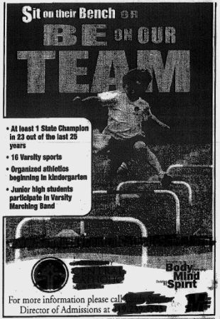

Bylaw 4-9-3 VIOLATION
No! Don’t do this.
This is a violation of 4-9-3 #1. This marketing does not involve the entire high school program and is solely focused on the school’s athletic program(s).

Slide 16
Bylaw 4-9-3 #6/ 4-9-4 #1
A school wants to market its summer basketball camp to students who do not currently attend the school. What are some ways it can do this and not be in violation of the recruiting bylaw? (Select all that apply)
  Post the camp brochure/registration link on the school website.
  Mail/email a camp brochure to a prospective student-athlete who attended a shadow day at the school.
  Hand out a camp brochure to a prospective student-athlete who does not attend the school.
  Mail the camp brochure to a general population as long as no direct mailing to specific individuals is conducted.
  It is never permissible to make a camp brochure available for a student who does not currently attend your school.
The answers are A and D.

Slide 17
Bylaw 4-9-3 #3
NEW CLARIFICATION FOR 2021-22: Schools are allowed to conduct an open house/information session/shadow day for all prospective students provided all elements of the school program are presented. During such an event, it is permissible for which of the following to occur... (Select all that apply)
  Have a coaching staff member guide the prospective student-athlete’s visit
  Have the coach exchange contact information with the student/parents
  Talk with a prospective student-athlete in the presence of a school administrator if the conversation centers around program procedures and expectations but not the student’s expected impact on the program
  Receive a small token, such as a “goodie bag,” containing items related to the school’s athletic program.
  Allow the athlete to practice/train with the team on that day
  Take a photo of the athlete in a team jersey
Answer: The answer is C, and partially D. Regarding answer D- during this visit athletes are permitted to receive a small token, such as a “goodie bag” containing an item or items, the value of which cannot exceed $25 and which CANNOT be solely related to the school’s athletic program (See 4-9-4 #7 Exception).
Notes:
Answer: The answer is C, and partially D. Bylaw 4-9-3 #3 indicates that an open house/information session (i.e. visit/shadow day) is permissible provided all elements of the school program are presented. Therefore, a shadow day cannot solely consist of a meeting with a coach, but that meeting can be included as part of the overall visit. During this meeting, the coach can answer questions about his/her program but is still prohibited from attempting to influence the enrollment of the student-athlete for athletic purposes.
Regarding answer D- during this visit athletes are permitted to receive a small token, such as a “goodie bag” containing an item or items, the value of which cannot exceed $25 and which CANNOT be related to the school’s athletic program (See 4-9-4 #7 Exception).

Slide 18
Bylaw 4-9-3 #5
Billboard and newspaper ads, etc. are additional forms of marketing. Are member schools allowed to use these platforms to attempt to secure the enrollment of prospective student-athletes?
  Yes, if the platform advertises all aspects of the school’s educational offerings and not solely athletics.
  Yes, if the platform includes no mention of athletics.
  Yes, if the platform is first approved by the OHSAA Executive Director’s Office.
  No, it is not permissible to use billboards or newspaper ads in order to attempt to secure the enrollment of prospective student-athletes.
The answer is A. It is permissible to use the school website or other forms of media such as billboards, newspaper advertisements, etc. to advertise all aspects of the school’s educational offerings (Bylaw 4-9-3 #5). Athletics may be included, but that cannot be the sole focus of the content.
NEW: Schools are permitted to utilize athletic advertisements of this nature so long as the advertisement simply congratulates a team and does not attempt to promote the athletic program (i.e. a billboard congratulating a state championship team).

Slide 19
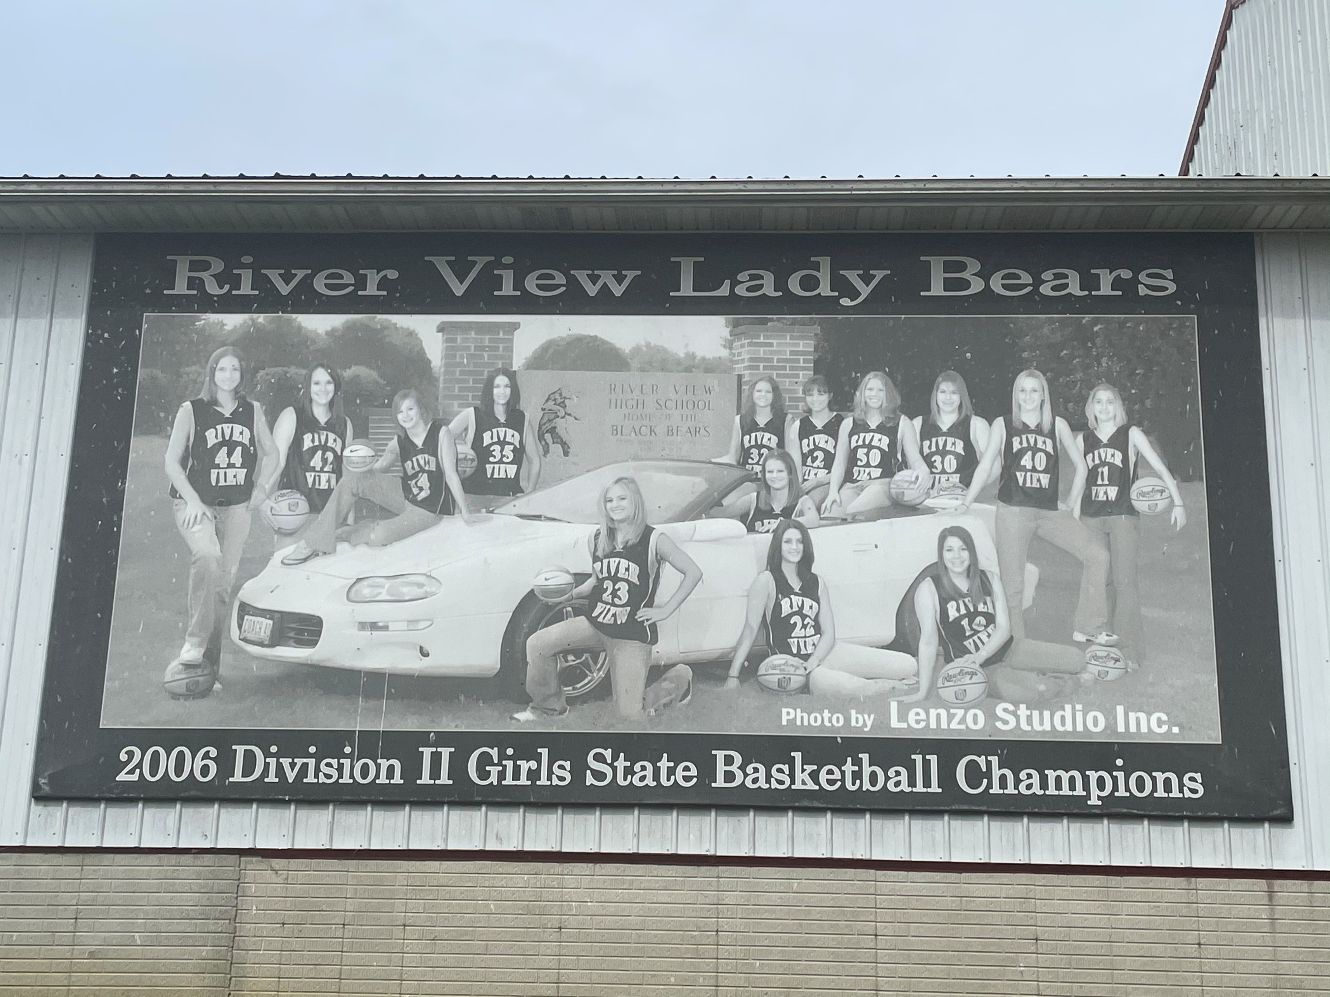
Bylaw 4-9-3 #5
This billboard promotes the school only using the athletic program and is not permitted in accordance with Bylaw 4-9-3 #5.
This billboard is congratulatory in nature and is permitted in accordance with Bylaw 4-9-3 #5.

Slide 20
Bylaw 4-9-3 #7
Bylaw 4-9-3 #7 indicates when it is permissible to invite prospective student-athletes and/or their parents to a high school contest or another athletic related event, such as a banquet or recognition ceremony. When may this contact may occur? (Select all that apply)
  When an admissions officer (not a coach) invites a student to this type of event.
  When the invitation is extended by the school administrator to an entire group or team and the participation is mutually agreed upon by the administration of BOTH schools/ organizations.
  When the student has completed a shadow day in contemplation of enrollment at the school.
  All of the above
Answer: The answer is B. The only time in which it is permissible to invite prospective student-athletes and/or their parents to a high school contest or another athletic related event is when the invitation is extended to an entire group or team AND the participation is mutually agreed upon by the administration of both schools/ organizations…. such as a school’s 7th or 8th grade team or non-interscholastic group such as a C.Y.O program.
Why are A/C not correct? Admissions officer contact cannot be solely related to athletics and just because one has shadowed does not mean that that the school can contact him/her for athletic purposes.
(Later in presentation discusses when solely athletic contact can be made)

Slide 21
Bylaw 4-9-3 #7
As referenced in the prior question…If an entire group of students is invited to a high school contest, what are some activities in which they are permitted to engage? (Select all that apply)
  Running out onto the field with the team & standing on the sideline
  Having a locker room visit
  Attending a pre-contest meal with the team
  Having an arranged interaction with the team prior to/after the contest
  None of the above
Answer: The answer is E. Though an invitation can be extended to a group of students, the group is not permitted to receive special accommodations during the event. The group can receive admission to the contest but then should be seated in the spectator area for the duration of the contest.
.

Slide 22
Bylaw 4-9-4
Forms of recruiting that are prohibited by this bylaw include but are not limited to…
NOTE: It would be impossible to list every single action which is a violation of the recruiting bylaw. Ask: Is the action being done in an attempt to influence a student’s enrollment at your school? If so, it is a violation. Don’t do it. If it could be perceived as an attempt to influence a student’s enrollment at your school, be ready for allegations. (i.e. what is the purpose of going to watch a 7/8 grade practice or game?)

Slide 23
IMPORTANT
NON-PUBLIC SCHOOLS: When is a coach allowed to initiate contact with a student-athlete who will be transferring to his/her school at the beginning of the next school year?
Once the student has requested information from the school where the coach is approved to work.
Once the student has submitted the application fee(s) at the school where the coach is approved to work.
Once the student has received written acceptance notification at the school where the coach is approved to work.
Once the student is withdrawn from the previous school.
Answer: The answer is B. Requesting information about a school does not permit contact (A) and written acceptance to a school is fine but is longer than necessary to wait (C). Once a student shows a serious interest in a school by submitting an application fee (for non-public schools) then that is when coaches are permitted to contact that student.

Slide 24
IMPORTANT
PUBLIC SCHOOLS: When is a coach allowed to initiate contact with a student-athlete who will be transferring to his/her school at the beginning of the next school year?
Once the student has requested information from the school where the coach is approved to work.
Once the new school has accepted the student’s application for enrollment
Once the student is withdrawn from the previous school.
Once the student is physically attending the new school.
Answer: The answer is B. Requesting information about a school does not permit contact (A). Once a student shows a serious interest in a school by submitting an application (for public schools) then that is when coaches are permitted to contact that student.

Slide 25
Bylaw 4-9-4 #2
WHAT WOULD YOU DO?: The coach of a non-interscholastic 7/8 grade team reaches out to a school coach and asks them to come and speak to their team about what the sport had meant to the coach, the benefits of the game, and some Q&A for 10 minutes or so. Here is a bylaw which addresses this type of meeting/function.
4-9-4 #2 Forms of recruiting that are prohibited by this bylaw include but are not limited to:— Meetings with, functions for or marketing to a select athletic group or individual/individuals, i.e., eighth grade team or individual sports participant, for the purpose of influencing enrollment at the high school.
The highlighted portion makes this situation difficult. If a coach would attend this event and only talk about “what the sport has meant to them and some of the benefits of the game”, then there would be no technical violation. However, if the speech or presentation would reference anything that could be construed as selling that coach’s program or trying to influence the students’ enrollment at their school, then the OHSAA would have to look into any allegations which came forward.

Slide 26
Bylaw 4-9-4 #3
An athlete had their club volleyball teammates ask if they could come to the school’s open gym even though they are not enrolled at the school. Is this allowed? Things to consider:
  Open gyms/fields/nets must consist of only UNSTRUCTURED FREE PLAY. A coach should not be providing instruction or leading the athletes in team play.
  Regarding open gyms…GSR 10.1.4 reads: No individual invitations, written or oral, are permitted to any student who is not enrolled and in that school district. However, school coaches may send an invitation to other school coaches to invite their students to an open gymnasium or facility.
  GSR 10.1.2 reads: The school may designate the sport or sports that will be played during the free play period but may not limit participation to a select group of students from within the school. The school may also designate the grade levels involved and may limit participation to students enrolled in the school.
  Open gyms/nets may be open to students from other schools who wish to come participate as long as your coach and/or athletes are not individually inviting outside students. Additionally, the coach cannot try to influence the student’s enrollment to the school during their attendance at the open gym.
  When individual non-enrolled students begin attending open gyms where they are not enrolled, as opposed to outside groups, it can lead to allegations of improper contact by that school’s coach with that athlete.

Slide 27
Bylaw 4-9-4 #4
After a student-athlete completes his/her shadow day at school in contemplation of enrollment, can student-athletes from a team text the student to try and make him/her feel welcome?
Yes, once a student visits a school then it is permissible for student-athletes at that school to contact that student.
No, student-athletes should not be texting a student until he/she has submitted his/her application fee to the school.
Maybe, depending on the nature of the student’s contact.
Answer: The answer is C. A coach should never ask the athletes on their team to text a prospective student-athlete. If the student elects to contact the prospective-student on their own, the contact can not be for athletic purposes. Though not all contact is “for athletic purposes,” the OHSAA would STRONGLY DISCOURAGE this type of contact, period. If the text messages are ever discovered and investigated, then it would be up to the Executive Director’s Office to determine if the contact was “permissible” vs. “impermissible.”

Slide 28
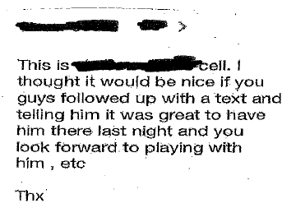
Bylaw 4-9-4 #4 Violation
No! Don’t do this.
4) — Any individual associated with a school, including team members, attempting to use electronic communication or a social media platform(s) to communicate with a prospective student-athlete about athletics prior to 1) the student’s application fee being submitted to the school (for tuition-based schools) or 2) the school accepting the student’s application
for enrollment (for non-tuition-based schools).
If sent prior to a student’s application fee being submitted, this would be considered the use of influence to secure the enrollment of a prospective student-athlete for athletic purposes.

Slide 29
Bylaw 4-9-4 #7
Can a non-public high school give away free summer camp registration to a 7-8 grade school for use in its school auction?
Yes
No
It depends on the 7-8 grade school
Remember
K-12 Buildings
Superintendent submit boundaries to OHSAA
Answer: The answer is C. The only time a high school can give away a free summer camp registration to a 7-8 grade school is when the contact with students in that school is permissible as outlined in one of the exceptions to Bylaw 4-9-2. Otherwise, Bylaw 4-9-4 #7 states that, “Providing favors or inducements, such as T-shirts or caps, to prospective student-athletes or their parents” is a form of recruiting that is prohibited. Therefore, unless contact with students in the school is permitted, free summer camp registration would be a violation

Slide 30
Bylaw 4-9-4 #7 Exception
A school is not permitted to provide favors or inducements such as T-shirts or caps, to prospective student-athletes or their parents.
EXCEPTION: A small token, such as a “goodie bag” containing an item or items, the value of which cannot exceed $25 and which cannot be related to the school’s athletic program, may be given to prospective students who “shadow” or visit a member school in contemplation of enrollment.

Slide 31
Bylaw 4-9-4 #8
Forms of recruiting that are prohibited by this bylaw include but are not limited to:
Providing financial aid or scholarships to a student-athlete on the basis of athletic ability/involvement. See Bylaw 4-10 for prohibitions on offering athletic scholarships to a student currently enrolled in a school.
Scholarships should be merit-based (academics) and need-based. Not based on their involvement in athletics!

Slide 32
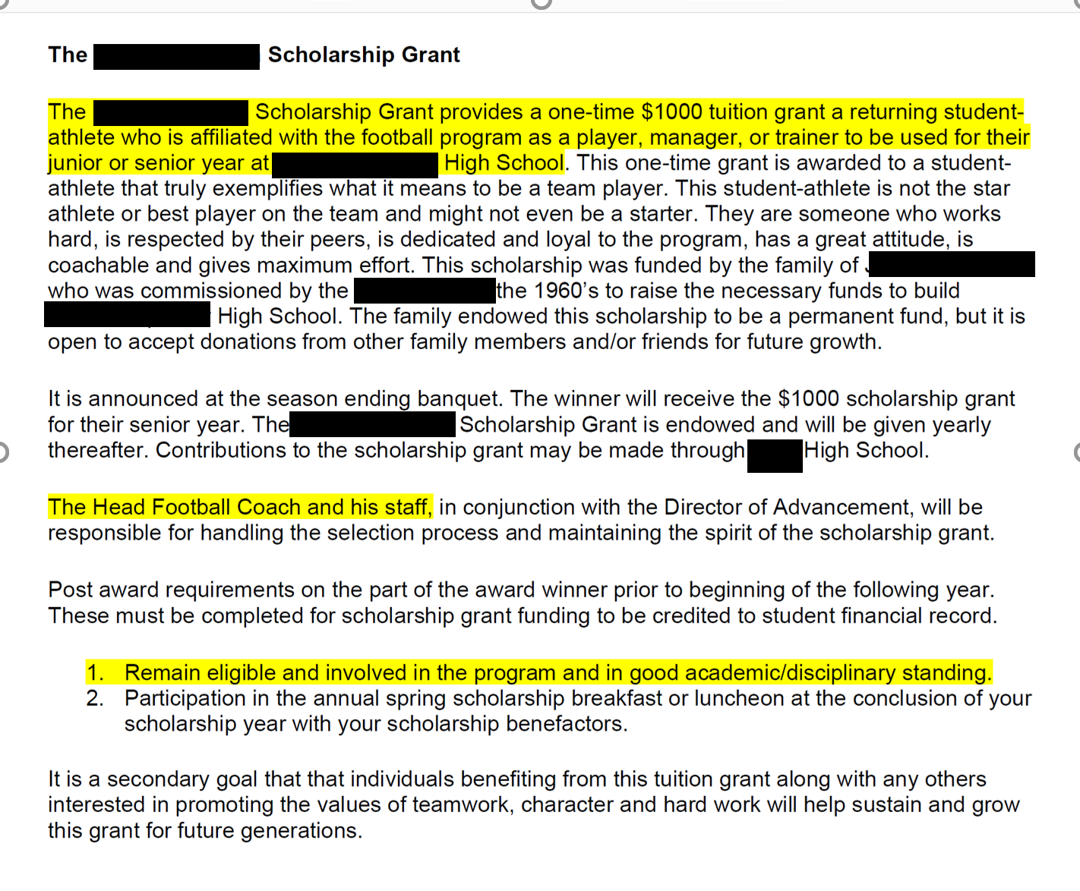
Scholarship
Violation
No! Don’t do this.

Slide 33
Bylaw 4-9-4 #10
If a coach leaves a school to pursue a coaching opportunity at another school, Bylaw 4-9-4 #8 indicates that “the coach shall refrain from any communication with any students at his or her former school.” Furthermore, if any student-athlete from the coach’s former school transfers to the new school where the coach is now approved as a member of the coaching staff, what happens?
The student-athlete is ineligible for 50% of the maximum allowable regular season contests in any sport in which the student competed during the 12 months immediately preceding the transfer.
The student-athlete is automatically ineligible for one year unless the new school can disprove the presumption of recruiting.
The student-athlete is automatically ineligible for one year.
The school where the student transferred is automatically ineligible for the postseason tournament in the sport in which the student followed the coach.

Slide 34
Bylaw 4-9-4 #10
Answer: The answer is B. The student-athlete is automatically ineligible for one year unless the new school can disprove the presumption of recruiting.
Though a student may or may not be subject to a transfer consequence at the new school (depending on his/her ability to meet a transfer exception), that consequence is completely independent of the recruiting bylaw. If an athlete follows a coach to a new school, then “said transfer or enrollment shall create a rebuttable presumption of recruiting and render the student ineligible for one year from the date of enrollment unless the recruiting can be rebutted.”

Slide 35
Bylaw 4-9-7, Penalties
Penalties for violations of the Recruiting Bylaw could include:
A period of ineligibility for the student upon enrollment at the school to which the student was recruited.
Sanctions placed on the coach who committed the violation, including removal from the OHSAA tournament.
Sanctions placed on the school to which the student was recruited (through Bylaw 11).

Slide 36
SOME parting thoughts:
The OHSAA is created to serve ALL members and to assist schools in supporting the mission of education-based sports
Sometimes questions related to Bylaw 4-9 are complicated and require thorough examination
We will work to provide individuals with a complete answer to any questions as soon a possible
Additional guidance can be found here: https://ohsaaweb.blob.core.windows.net/files/Eligibility/4-9GuidanceRecruiting.pdf

Slide 37
OHSAA Compliance Department
Ms. Kristin Ronai, Director of Compliance & Legislative Affairs
Email: kronai@ohsaa.org
Mr. Ronald Sayers, Manager of Membership & Compliance
Email: rsayers@ohsaa.org

