Slide 1
OHSAA Rule Clarifications and Interpretations
March 15, 2026

Slide 2
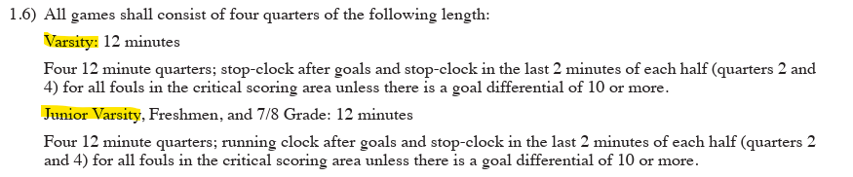
Timing
I wanted to clarify on the timing for games this year for girls lacrosse. The rule book says the clock will stop during the last minute of every quarter for fouls in the CSA which is what I thought it was. The OHSAA regulation sheet for 2025-2026 states only in the 2nd and 4th quarters. Can you clarify which will be used so we can train appropriately? Thanks!
The OHSAA regulation sheet above is incorrect. I have brought it to OHSAA. It should have been fixed.
Correct timing = stop clock on fouls in CSA in last min of each quarter unless 10-goal differential.

Slide 3
Boundary Restart
As we have done the past few years, are we still requiring all boundary ball restarts to take place with the player starting out of bounds, even though there is a section of the rule book that states if they are within 2m of the boundary they can pick it up and go?
Due to all of the rule changes that encourage the flow of the game, it only makes sense to allow the situation as described in 6.3.1 SITUATION D, p. 47.

Slide 4
Class 1 upgrade

Slide 5
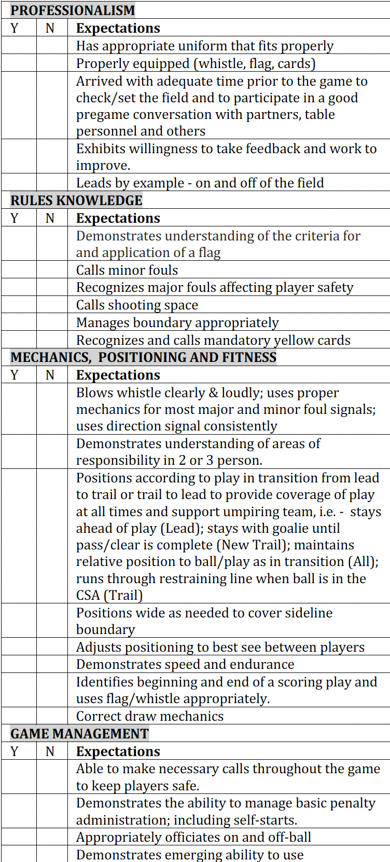
Class 1 upgrade

Slide 6
Early Entry v Offside

Slide 7
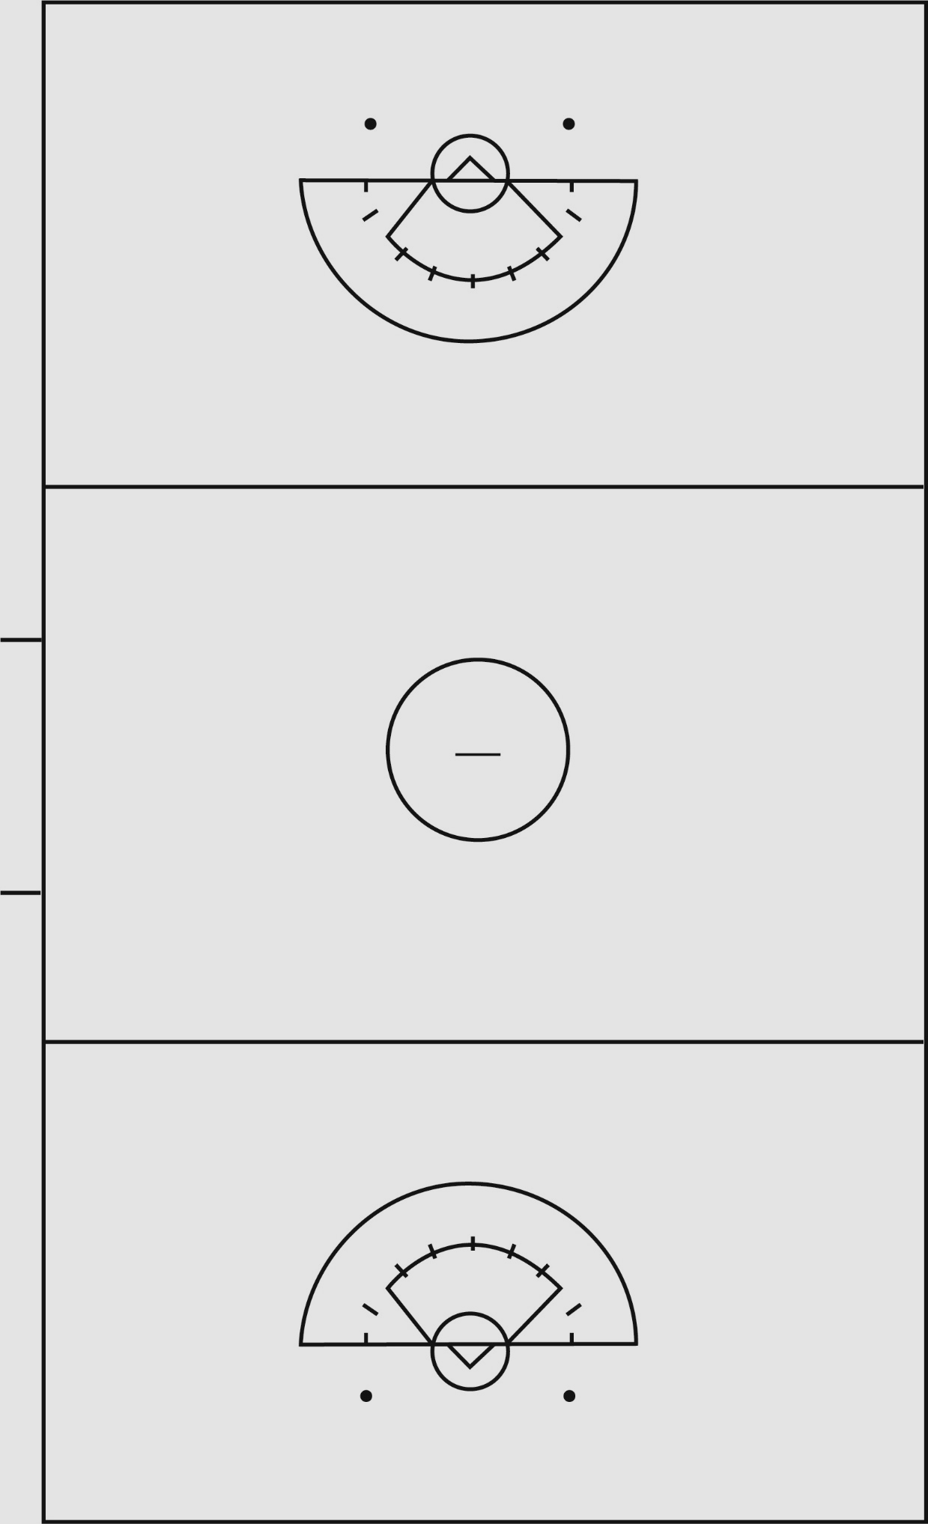
Early Entry
Spot of Ball
Offender 4m towards own goal
Self-start

Slide 8
Offside
•CALL TIMEOUT
•Enforced at spot of the ball below the RL
•Correct the offside
*Offender behind
•Whistle Start
OFFSIDE - Defense
Below GLE = Dot
Outside CSA = Spot
Inside CSA/above GLE = 12m
OFFSIDE - Offense
Closest defense gets ball
At spot at least 8m from GC
In CSA - Below GLE = Dot
OFFSIDE - Both
Alternate Possession at spot
In CSA - Dot

Slide 9
Three Seconds
Enforced at spot of the ball
Below GLE = Dot
Outside CSA/above GLE = 12m
Between 8/12m = 12m
In Arc = 8m

Slide 10
Coach Misconduct
P. 71 12-3.
….If a Red card is issued to the coach due to the behavior of bench personnel, the head coach and the offender shall be removed from the field...
Two yellow cards do not substitute for a Red card.

Slide 11
Test Questions Clarification

Slide 12
Offside
The Red team is offside in its defensive end of the field when the whistle is blown with eight minutes left in the second quarter. The ball is inside the 8-meter and the opposing team is not on a scoring play. How is play restarted?
Call time-out. Place the player with the ball at the center of the 12m fan and direct the closest defender to go behind. Clear the lane and whistle start.

Slide 13
Draw
If both players draw illegally or it cannot be determined why the draw was illegal, the official will:
Call a time-out and a re-draw will occur at the center line.
Notes:
No APs

Slide 14
Draw
During the draw, Blue No. 16 does not draw up when the whistle is blown and the ball shoots out and lands 2 yards from the restraining line. The official immediately blows the whistle and shows direction for White team possession. How is play restarted?
Allow any player from the White team to self-start play from the spot of the ball.
Notes:
Not back to center. No whistle needed. No stop clock.

Slide 15
Draw
If the ball goes directly out of bounds from a legal draw without anyone touching it.
How is play restarted?
Call timeout and bring the ball back to the center and administer a redraw.
Notes:
No Aps and no awarding of the ball. Don’t forget the TO.

Slide 16
Eye Shade
A player is wearing red eye shade in one solid stroke horizontally across the top of their cheekbone. The official sees the eye shade just before the draw administration to start the game. What should the official do?
Proceed with draw administration to start the game as the eye shade is worn properly on the cheekbone.
Notes:
Color is ok

Slide 17
Goal Circle Violation
The Red team goalkeeper sets the ball on the ground and does not exit the goal circle when Red No. 4 runs in to play the ball. What is the set up?
Give the ball to the nearest opponent on the closest dot, Red No. 4 moves 4 meters away.
Notes:
Not an 8m. GK does not clear. Away – not behind

Slide 18
Timing
The score is 14-2 and there is under a minute left in the fourth quarter. The official has their flag raised on the scoring play for a defensive major foul. When the whistle is blown and the players are clearing for an 8-meter free position, time expires on the game clock to end the game. What should the officials do?
Instruct the players that the game has ended and no free position will be administered.

Slide 19
Timing
The score is 12-1 with 5 minutes left in the fourth quarter. The clock shall be stopped for which of the following:
There are only 3 events that require a timeout regardless of score – Card, Injury or stick check

Slide 20
Timeout in the Goal Circle
A possession time-out is called while the Red team's goalkeeper has possession of the ball inside the goal circle and no foul has been called. Where will the restart take place?
With a Red team player on the closest dot.

Slide 21
Flag
On a held whistle when the flag is raised and the goalkeeper commits the next foul ending the scoring play, what happens next?
Administer free position on the closest 8-meter hash, penalty zone is cleared, and the goalkeeper is placed 4 meters behind.
Notes:
GK serves her penalty

