Slide 1
OHSAA Deadlines, Reminders and Other Information
March 29, 2026

Slide 2
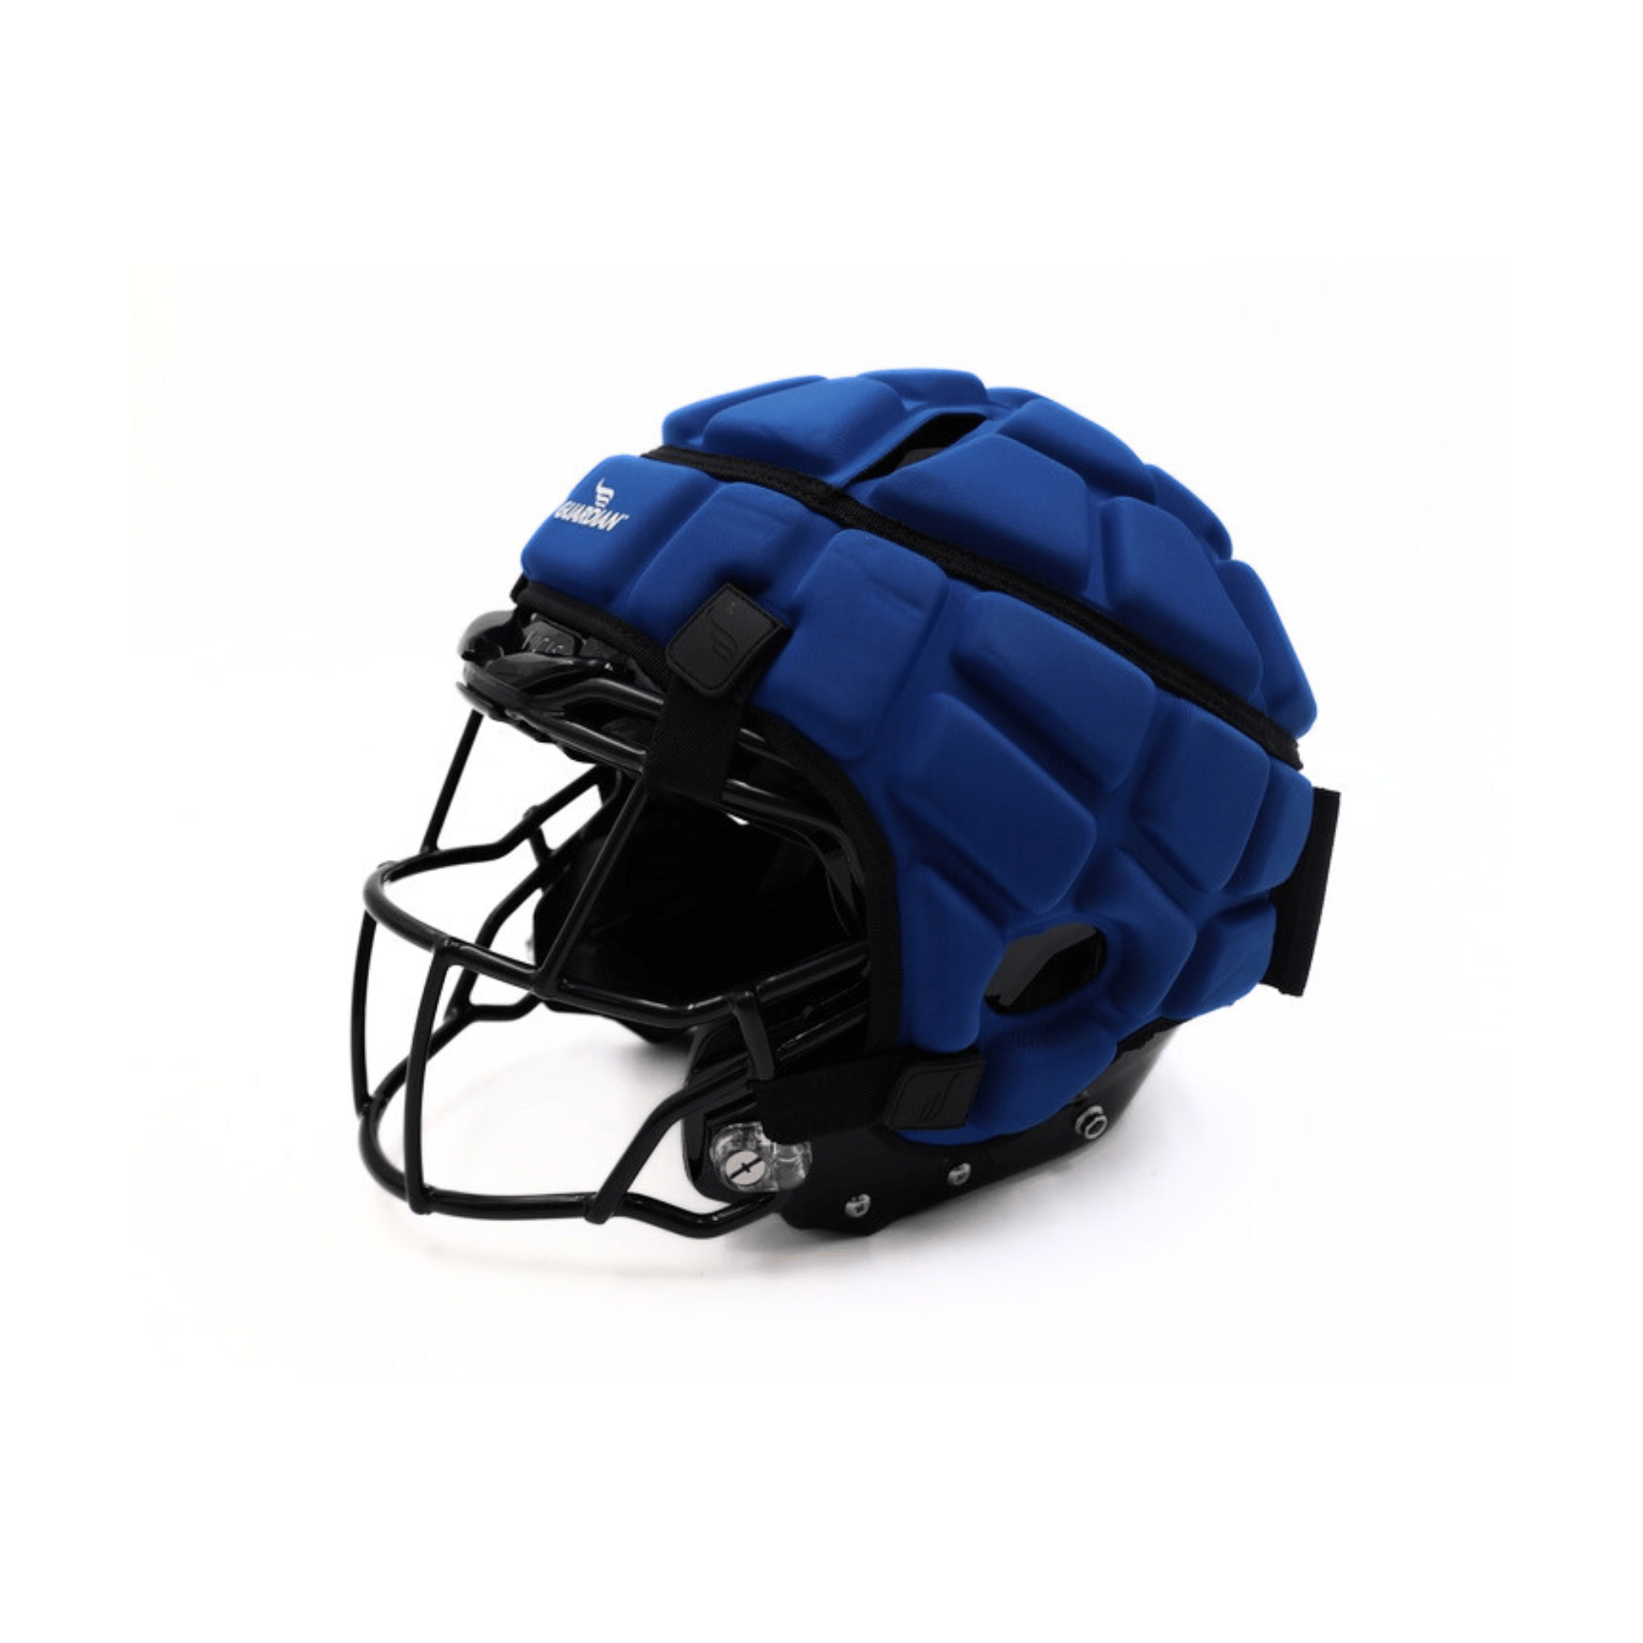
Guardian Cap
NFHS is permitting the Guardian Cap for goalkeepers only.

Slide 3
Upcoming Webinars
There will not be a presentation next week due to Easter.
The next presentation will be April 8 @ 7:30. It will be a replay of the first webinar about the draw. All are welcome to join but meeting credit will be given only to those officials who were not able to attend the original presentation on March 15th.
The last presentation will be on April 12th.
Links to both presentations will be sent out closer to each date.

Slide 4
Deadline Reminders
SRI closes - April 14 @ 11:59pm
Test completion date - April 26 @11:59pm
  OHSAA link was sent to all. Let me know if you need it.
  USAL test results need to be sent to me: lfickert@ohsaa.org
Local meeting completion by May 1

Slide 5
Questions? Concerns?

