Slide 1
Baseball/Softball
General Meeting
OHSAA Umpire Information
Revised 2026

Slide 2
Topics of Discussion
Umpire Uniform
Safety Issues
  Weather
  Concussion
Filing OHSAA Game Reports
Game Ending Procedures
Umpire Conduct
Ejections and Sporting Conduct
Officials Insurance
OHSAA Regulations
Assignments/Conflicts
Tournament Selection Procedure

Slide 3
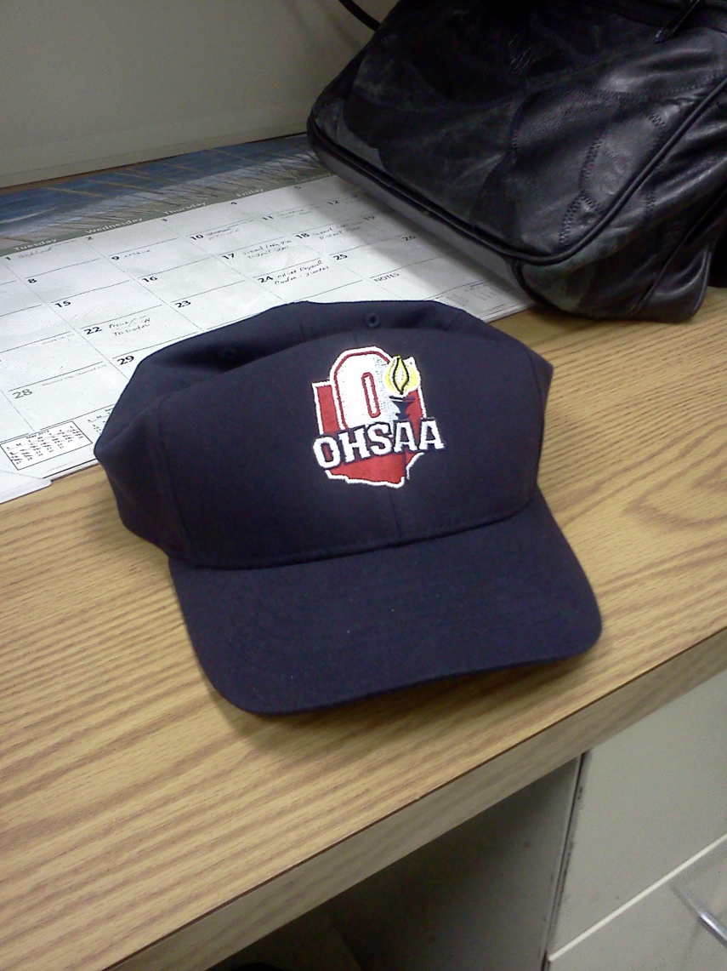
UNIFORM REQUIREMENTS

Slide 4
UNIFORM REQUIREMENTS
OHSAA HAT LOGO
NAVY BLUE OHSAA SHIRT & LOGO
RED UNDERSHIRT
GRAY SLACKS – BOTH UMPIRES MUST BE DRESSED ALIKE – DEFAULT SHADE CURRENTLY DIFFERS IN BASEBALL AND SOFTBALL
Notes:
Uniform requirements for softball officials are included in the Pre-season Manual. The new OHSAA Logo will be required for the 2013 Softball Season.

Slide 5
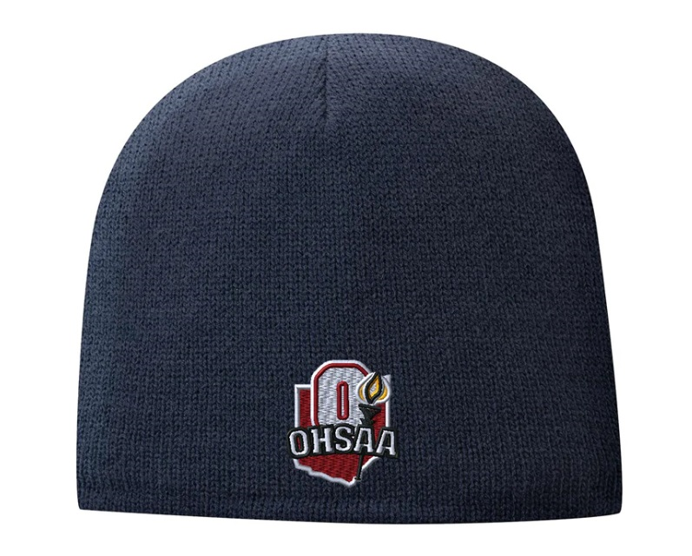
Knit Cap Optional – Cold Weather

Slide 6
OHSAA SOFTBALL
UPCOMING CHANGES - UNIFORM
The OHSAA wants to give all of our umpires advance notice that in the coming years we will be making a transition to have charcoal gray pants as our default color and eventually to become our only color for pants.
This is primarily for two reasons – first, the charcoal shade seems to hold the color better without fading and second, as more and more baseball/softball organizations make this change it appears that many vendors are reducing the availability of heather gray pants.
Also, as we make this transition, we will take the opportunity to use navy blue ball bags as our primary choice of color for that item. For umpires now making purchases of these items we suggest using this opportunity to make adjustments.

Slide 7
OHSAA SOFTBALL
UPCOMING CHANGES - UNIFORM
We are taking this opportunity to further update you on next steps in this transition:
For 2026 - In the event the umpires do not agree heather gray pants shall be worn. This will allow the umpires to wear either pants color, but all must be dressed alike. (NO CHANGE)
For 2027 - In the event the umpires do not agree charcoal gray pants shall be worn. This will allow the umpires to wear either pants color, but all must be dressed alike.

Slide 8
UNIFORM REQUIREMENTS
LOGO- OHSAA HAT & NAVY OHSAA SHIRT
RED UNDERSHIRT
JACKET – RED SHOULDER STRIPE STYLE
BLACK BELT & BLACK SHOES
BALL BAGS – COLOR AND NUMBER
NO WRIST WATCHES
APPLIES TO ALL LEVELS OF PLAY
PRIDE YOURSELF ON BEING NEAT
Notes:
Uniform requirements for softball officials are included in the Pre-season Manual. The new OHSAA Logo will be required for the 2013 Softball Season.

Slide 9
SAFETY ISSUES
OHSAA has always played key role in developing polices covering all aspects of safety for student- athletes
Weather, Concussion Management, and Equipment are just three of these that are important for umpires
Safety is an important responsibility for all involved

Slide 10

INCLEMENT WEATHER
STOP CONTEST
MANDATORY
UNDERSTAND REVISED WEATHER POLICY
GO TO SAFE LOCATION
30 MINUTE MINIMUM WAIT
RESUME AT LATER DATE – IF NEEDED
Notes:
Please refer to your Preseason Manual for the precise language regarding Lightning and Inclement Weather. Competition or practice shall be suspended once lightning has been recognized or thunder heard. It is Mandatory to wait at least minutes after the last flash of lightning is witnesses or thunder is heard prior to resuming practice or competition.

Slide 11
Revised Weather Policy - Thunder and Lightning
1. If thunder is heard, the game will be stopped and the 30-minute clock kicks in-NO EXCEPTIONS!
2. If lightning is seen (but no thunder heard), the game will be stopped and the Game Administrator(s), Umpires, and Head Coaches will convene and determine what type of delay will be administered. If there is lightning in the area, the 30-minute clock kicks in.

Slide 12
Revised Weather Policy - Thunder and Lightning
3. At night (after dark) under certain atmospheric conditions, lightning flashes may be seen from distant storms. In these cases, it MAY be safe to continue. If no thunder can be heard and the flashes are low to the horizon, the storm may not pose a threat. Independently verified lightning detection information would help eliminate any uncertainty. If any member of the group assessing conditions is uncertain, delay for 30 minutes!

Slide 13
Revised Weather Policy - Thunder and Lightning
4. Lightning detection devices may be used to stop the contest if lightning is in the area (usually 10 miles) even if it is not seen or thunder heard. Often, school medical personnel are monitoring this equipment – obtain their input as part of your discussions.
5. Error on the side of safety. If there is a delay, players, coaches and officials must clear the field of play and seek cover. The host school is responsible to have an evacuation plan to get everyone to designated safer areas.
6. The “thirty minute clock” is re-started each time that thunder is heard or there is lightning in the area.

Slide 14
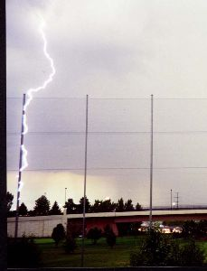
Lightning Facts
Can Heat the Air to 50,000 degrees which is 5 times hotter than the sun.
Lightning can strike the same place multiple times
Lightning can strike up to 10 miles away from the center of the thunderstorm
One of the top three thunderstorm related killers
It is estimated that ~ 400 people are struck each year (10 percent are fatal)

Slide 15

Lightning Hazard Areas
Radio and Radio Equipment
(1.2%)
Golf and Trees
(1.7%)
Open Fields
(45.0%)
Telephone
(4.0%)
Farm and
Heavy Equipment
(5.0%)
Under Trees
(23.0%)
Water
(13.6%)
Golf
(6.5%)
Lightning Casualties In U.S. (1959-1994)
Notes:
These are the activities that have the most lightning casualties associated with them in the U.S. Casualties means both deaths and injuries combined.
We’re going to go through these one by one to show that some school activities can put students at high risk.

Slide 16
Thirty Minute Rule
Competition or practice shall be suspended once lightning has been recognized in the area or thunder is heard. It is mandatory to wait at least 30 minutes after lightning is out of the area or thunder is heard prior to resuming practice or competition. Any subsequent lightning in the area or thunder after the beginning of the 30-minute count shall reset the clock, and another count shall begin.

Slide 17
INCLEMENT WEATHER
If lightning is imminent or a thunderstorm is approaching, all personnel, athletes and spectators shall evacuate to available safe structures or shelters.
If you note that other school events, aside from your game are continuing, notify the nearest athletic administrator. These games are not under your direction.

Slide 18

Safe Locations
10
9
8
7
6
5
4
3
2
1
0
Lightning Certified Facility
Lightning Protected Building
Seek Proper Shelter
  Buildings Much Better
  Than Vehicles
  Vehicles Offer
  Some Safety
  No Place Outside
  Is Safe Near A
  Thunderstorm
Relative Lightning Protection
Outdoors
Notes:
We talked about going to proper lightning shelters, but what constitutes a proper lightning shelter? Of the resources most commonly available, a large fully enclosed substantially constructed building is your best bet, such as your typical house or school. By substantially constructed, we mean it needs a lot of wiring and plumbing in the walls.
If a building isn’t available,a vehicle with a metal roof and metal sides is a reasonable second choice. Notice how I emphasize it’s the metal shell that protects you, not the rubber tires insulating you from the ground -- that’s a myth that just won’t die!

Slide 19
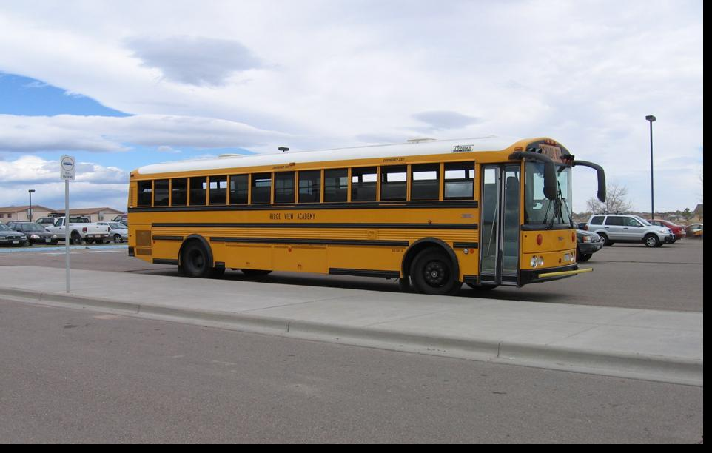
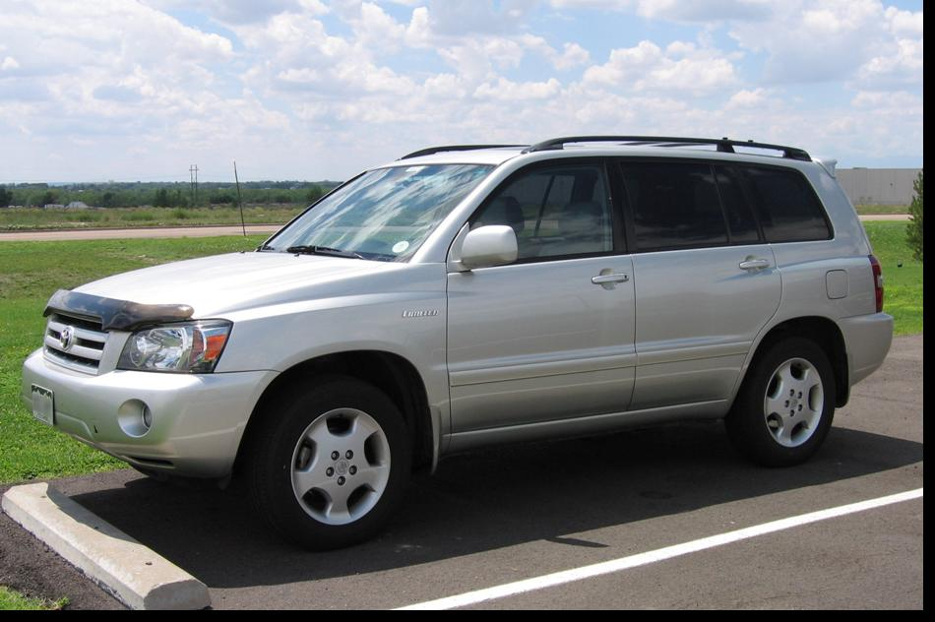
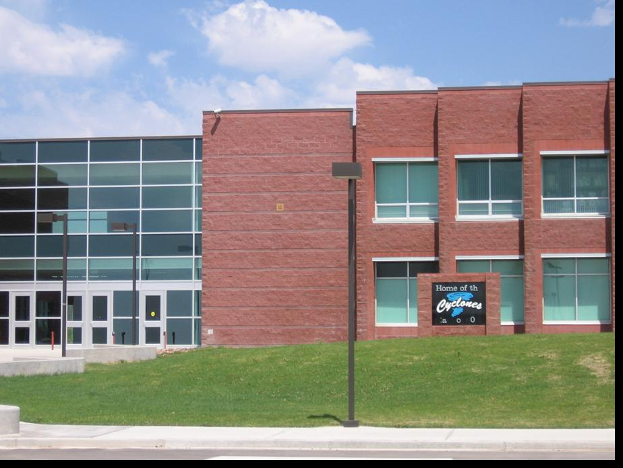
Safe

Slide 20
INCLEMENT WEATHER
REVIEW PRESEASON GUIDE WEATHER-RELATED INFORMATION
THESE RULES MUST BE ENFORCED BY ALL!

Slide 21
CONCUSSION MANAGEMENT
OHSAA has always played key role in developing polices covering all aspects of safety for student- athletes
Ohio law which became effective middle of 2013 season included many OHSAA regulations and added several aspects to previous regulations

Slide 22
CONCUSSION MANAGEMENT
State law regulates some aspects
Return to play has been updated
Contest officials and others are now required to have completed an approved training program in concussion recognition - MUST BE COMPLETED EVERY THREE YEARS
Other portions of the law impact schools, coaches, parents and student athlete participants

Slide 23
RETURN TO PLAY PROTOCOL
If a student is removed from practice or competition due to a suspected concussion or head injury, the coach or referee who removes the student shall not permit the student, ON THE SAME DAY THE STUDENT IS REMOVED, to return to that practice or competition or to participate in any other practice or competition for which the coach or contest official is responsible.

Slide 24
RETURN TO PLAY PROTOCOL
The student athlete can return on a subsequent day after the student’s condition has been assessed by an authorized health care provider and the student receives written authorization from the provider stating that it is safe to return to practice or competition.
This is a school responsibility.

Slide 25
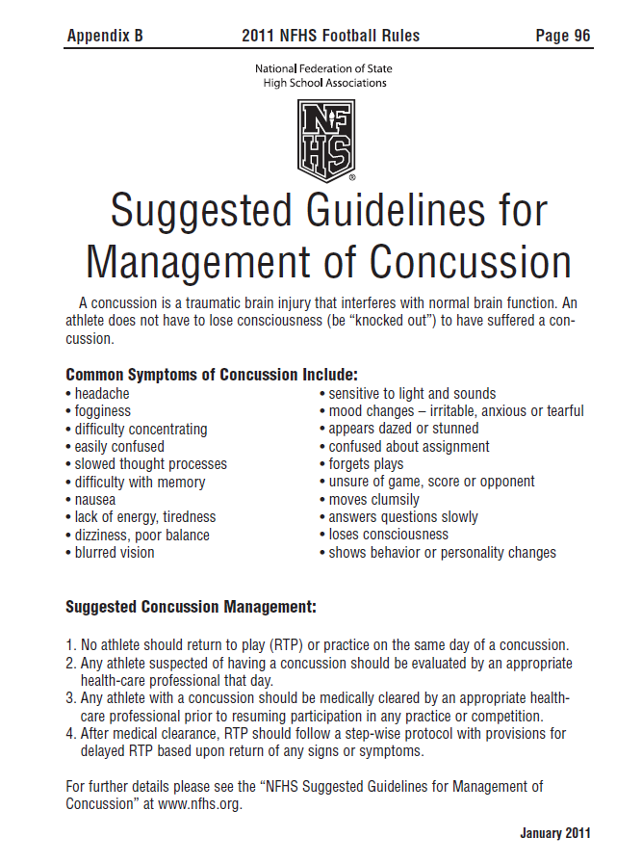
CONCUSSION MANAGEMENT
Remains in ALL NFHS Rules Books
List of Common Symptoms of Concussion
Other information on this page does not reflect Ohio law or OHSAA regulations
Case Book plays may not reflect Ohio law and OHSAA regulations
Under current Ohio Law officials are no longer involved in handling Medical Authorization to Return to Play Documents. This is now a school responsibility.
Notes:
Comments: A new form has been developed to document when a player, who has been removed due to exhibiting signs, symptoms or behaviors consistent with concussion, has been approved to return to play that day. The form can be found on the OHSAA web site at www.ohsaa.org on both the sports medicine link and the Volleyball page. Officials who have removed a player under this rule shall not permit the player to return to play without this signed form. The official should then make a copy of the form and forward it to the OHSAA office.

Slide 26
Filing OHSAA Game Reports
To submit any report for player/coach ejections, sportsmanship, facility, and medical/concussion:
1) Reports are ONLY accessible from the contract details of the contest you officiated in your Dragonfly account. Reports are NOT accessible in the Dragonfly App. Do NOT use the app for reporting. Officials will fill out the form electronically on DragonFly. Go to “My Assignments” (may need to go to Past Games). Click on the contest needing the report. Scroll down to the bottom of the page and click “Add Document”. Please complete one report per offending school and when there are ejections a separate report for each person ejected.

Slide 27
Filing OHSAA Game Reports
2) Follow the process as stated in the OHSAA Officiating Handbook (pages 14 & 15):
https://ohsaaweb.blob.core.windows.net/files/Officiating/OHSAAOfficialsHandbook.pdf
Reports must be completed within 48 hours.
Contact the AD or principal directly by phone, email, or in person and let them know you are filing the report in Dragonfly.
Make sure that you have the correct player #, or player’s name or coach’s name.
Be specific and factual and to the point. Leave out any thoughts or beliefs and state the rule where applicable.

Slide 28
Filing OHSAA Game Reports
The Officials Report Form may also be used to report good or poor sportsmanship, concussions, severe injuries, facility problems, or equipment problems.
Ejections other than players or coaches and other items of which the Director should be made aware must be submitted.
The school AD and OHSAA will automatically be sent an email through Dragonfly regarding this report upon clicking on submit.
Response email notifications will be sent once the protocol has been completed.
An official failing to follow the ejection protocol and/or failing to file the Officials Report may result in a maximum fine of $100 to the official per occurrence.

Slide 29

OHSAA ADOPTIONS – GAME ENDING PROCEDURES
OHSAA GAME ENDING PROCEDURES DIFFER FROM NFHS RULES
GAME ENDING PROCEDURES - DIFFER IN REGULAR SEASON VS OHSAA TOURNAMENT
FOR REGULAR SEASON -
GAME SUSPENDED BEFORE 5 INNINGS – POINT OF INTERRUPTION WHEN RESUMED
GAME SUSPENDED AFTER 4 ½ INNINGS – HOME TEAM AHEAD - GAME OVER
GAME SUSPENDED AFTER 4 ½ INNINGS – VISITING TEAM AHEAD – POINT OF INTERRUPTION
Notes:
Specific examples of game ending scenarios are included in your preseason manual.

Slide 30
OHSAA ADOPTIONS
REGULAR SEASON GAMES BEYOND 5 INNINGS ARE COMPLETE
EXCEPTIONS ARE TIES & WHEN VISITORS HAVE TIED/TAKEN LEAD AND INNING IS NOT COMPLETED
GAMES CAN NEVER BE “STARTED OVER”
EXAMPLES – FOUND IN WHITE BOOK & SOFTBALL MANUAL
OHSAA TOURNAMENT GAMES ARE PLAYED TO COMPLETION
RULE 4-2-3 AND TEN RUN RULE ARE CONSIDERED COMPLETION

Slide 31
OHSAA ADOPTIONS
TEN RUN LEAD – AFTER 5 INNINGS – GAME OVER – 4 ½ FOR HOME TEAM
REGULAR SEASON & TOURNAMENT PLAY
NO EXCEPTIONS – ALL LEVELS
Notes:
Ten run rule is in effect for member schools for both the regular season and the OHSAA post season tournament.

Slide 32
UMPIRE CONDUCT
OFFICIALS PLAY A ROLE JUST AS DO ALL PARTICIPANTS
YOU SERVE AS A ROLE MODEL
RESPECT THE GAME

Slide 33
EJECTIONS
REMINDER
  WHEN EJECTIONS HAPPENS
    PHONE CALL REQUIRED
    ONLINE REPORT MUST BE SUBMITTED – DRAGONFLY –PROCESS COVERED EARLIER
    IF COACH EJECTED
      $100.00 FINE
      ONLINE COURSE MUST BE TAKEN
      ONLINE COURSE THROUGH NFHS
      FEE FOR ONLINE COURSE
      TWO GAME SUSPENSION
Notes:
WHEN A COACH OR STUDENT-ATHLETE IS EJECTED FROM A CONTEST AN OFFICIAL’S REPORT MUST BE FILED WITH THE MEMBER SCHOOL AND OHSAA.
PLEASE NOTE THE DIFFERENCE BETWEEN EJECTIONS FOR UNSPORTING CONDUCT AND “RESTRICTION TO THE BENCH” AS INDICATED IN THE PLAYING RULES FOR SOFTBALL.
REMEMBER TO “RESPECT THE GAME”

Slide 34
OHSAA Rules Affecting Ejections
Decisions of ALL Officials are FINAL
After an Ejection:
Bylaw 8-3
COACHES
LEAVE the Facility
Ineligible for all remaining play that day
Ineligible for next TWO matches
May not travel to or sit with team
Pays $100.00 Fine
Completes NFHS Course –
Teaching and Modeling Behavior
PLAYERS
Remain supervised in Bench area
Ineligible for all remaining play that day
Ineligible for next TWO contests
May not travel to or sit with team
Notes:
Just a quick reminder, the decisions of officials are final as per OHSAA bylaw and NFHS rules. VB playing rule 12-2 prescribes the protocol for dealing with misconduct.
This slide is a review of the procedures for both player and coach ejections. Players must remain supervised in the bench area and will miss the remainder of all contests on the day of the ejection plus the next two matches. While ejected they may not travel with or sit with the team. For coaches, they must leave the facility and are also denied participation for the rest of the that day and for the next two matches at the same level as the ejection. In addition, coaches must pay $100 and complete the Teaching and Modeling Behavior Course at www.nfhslearn.com. Officials are required to report all ejections to the office using the procedure found on myohsaa.

Slide 35
SPORTING CONDUCT
Bench Restrictions should be used where appropriate
Rule 3 covers when Ejection, Bench Restriction, or Discretion is applicable
Both coaches and players (Softball only) can be restricted to the bench

Slide 36
UMPIRE JURISDICTION
UMPIRE JURISDICTION BEGINS UPON THE ARRIVAL OF ONE UMPIRE WITHIN THE CONFINES OF THE FIELD AND ENDS WHEN THE UMPIRES LEAVE THE FIELD AT THE CONCLUSION OF THE GAME.
ANY UMPIRE’S DECISION WHICH INVOLVES JUDGEMENT, SUCH AS WHETHER A HIT IS FAIR OR FOUL, WHETHER A PITCH IS A STRIKE OR A BALL, OR WHETHER A RUNNER IS SAFE OR OUT, IS FINAL.
VIDEO REVIEW IS NOT PERMITTED UNDER NFHS RULES
CONSULT WITH YOUR PARTNER WHEN YOU MAY BE MISSING A PIECE OF THE PLAY – BUT A DECISION MUST ALWAYS BE MADE FIRST!
CONSULT RULE BOOK WHEN NECESSARY

Slide 37
Rule Books and Publications
EVERY UMPIRE owns the rules!
RULE BOOKS and other publications must be available!
Umpires must have at game site
Refer to as needed

Slide 38
Game Management
Umpires’ responsibility is on the field
Game Administration and Site Management is a school responsibility.
Includes weather issues, the rare case of spectators causing problems that need attention, or other emergencies.
Know if game management is available or if the head coach is filling that role.
Know who to go to if assistance is needed.

Slide 39
OHSAA Officials Insurance
General Liability
Participant Accident Benefits
https://ohsaaweb.blob.core.windows.net/files/Officiating/forms/OfficialsBenefitSummary.pdf
Claims & Questions • Report claims to Hylant, 565 Metro Place South., Suite 450, Dublin, OH, 43017 to the attention of Cathy Noskowiak. Claims can also be emailed to cathy.noskowiak@hylant.com
• For questions regarding this summary, please contact Cathy Noskowiak at Hylant – cathy.noskowiak@hylant.com

Slide 40
OHSAA Officiating Regulations
Only Class One officials are permitted for varsity regular season games
Exceptions must be approved by OHSAA office
Class Two officials will work only sub-varsity games
Advancement Process – need local association assistance in helping umpires to be successful in going through this process.

Slide 41
Assignments/Conflicts
Handling Conflicts of Interest
Avoid These!
Key is PERCEPTION
Be aware of possible issues
Work with Assigners
Assigners know to switch officials to another contest and will work with you

Slide 42
TOURNAMENT SELECTION
Based on process described on OHSAA website – Officiating Page
Input from many sources
Data gathered is used for the ensuing season
Participate in Local Association Selection Process

Slide 43
TOURNAMENT SELECTION
OHSAA office selects/assigns state and regional officials from pools
District Athletic Boards handle District and Sectional Tournaments based on pools developed by OHSAA

Slide 44

Tournament Officials Rating and Voting System
For the sports of:
Baseball
Basketball
Football
Soccer
Softball
Volleyball
Wrestling

Slide 45
Rating & Voting Points System Overview
Coaches
School Vote
Local Associations
Officiating Leaders
Total Points Possible
15
Points
15
Points
15
Points
15
Points
60
Points

Slide 46
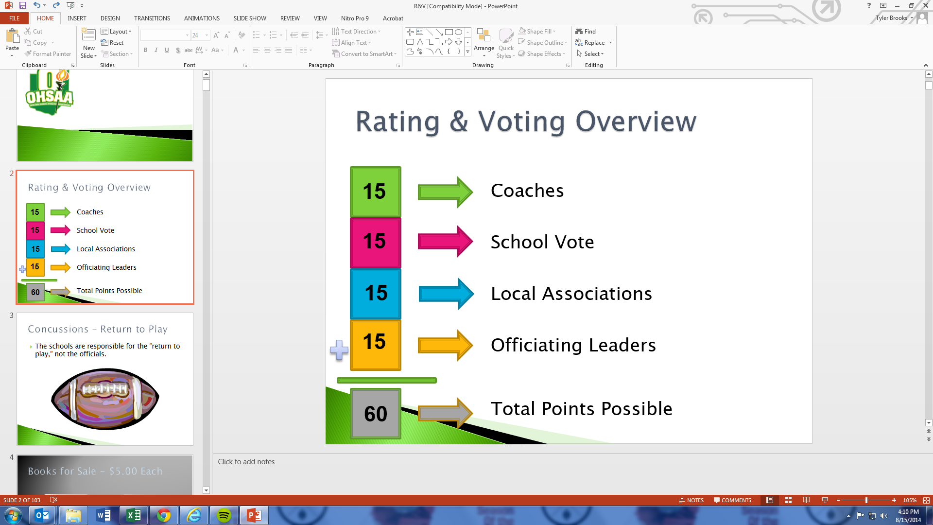
Coaches
Coaches vote for officials
The maximum number of votes an official could receive from the Coaches vote is 15.

Slide 47
School Vote
Athletic Directors are responsible for submitting the ballot, preferably after consulting with their coach.
Continue to vote for a maximum of 15 officials.
The maximum number of votes an official could receive from the School vote is 15.

Slide 48
Local Associations
Associations will vote for 30% of their membership.
The 30% will be divided into 5 groups, each containing 6%.
Group 5 (highest) will receive 15 votes.
Group 4 – 12 votes, Group 3 – 9 votes, Group 2 – 6 votes, & Group 1 – 3 votes.

Slide 49
Local Associations
The selection of officials will be determined by a vote of all members, including class 2 officials.
All class 1 officials will be eligible for consideration and may not be excluded for any reason (except if they voluntarily withdraw).
Officials will not be voted for by position.

Slide 50
Local Associations
An official belonging to more than one Association would be eligible for consideration from all Associations in which a member, but receives the vote only from the Association in which the official ranked highest.
The selection procedure must be conducted in an open and transparent fashion.

Slide 51
Local Associations
Selection results must be made available to all Association members.
The OHSAA may direct a District Administrator to conduct an Association’s selection procedure if it determines it is necessary.

Slide 52
Officiating Leaders
Includes:
  Assigners
  Directors of Officiating Development (DODS)
  OHSAA Administrators
  OHSAA-assigned Observers
  Others as determined by the OHSAA

Slide 53
Officiating Leaders
Assigners (of Varsity Sports)
  Must have an evaluation/observation program in place.
  Vote for 25% of the number of varsity officials they assign.
  Vote on a 3-point scale, with 1 being the lowest and 3 being the highest.

Slide 54
Officiating Leaders
DODs, OHSAA Staff
  Vote on a 5 point scale with 5 being the highest
Others selected by OHSAA
  Vote for a maximum of 30 officials
  Would include approved observers

Slide 55
Ranking and Pools (1 of 4)
Officials will be ranked in their Athletic District of residence from highest to lowest.
Ranked officials will then be divided into pools.
Pools are groups of officials eligible for various levels of the tournaments.

Slide 56
Ranking and Pools (2 of 4)
The District and Sectional pool will be approximately twice as large as the number of officials to be assigned.
The Regional pool will be approximately 2.5 times the number of officials needed.
The State pool will be approximately three times the number of officials needed.

Slide 57
Ranking and Pools (3 of 4)
Tournament eligible officials complete a tournament questionnaire.
Upon completion of the questionnaire process, the rankings and pools are reviewed to make certain there are enough officials in each pool.

Slide 58
Ranking and Pools (4 of 4)
Regional and State assignments are finalized by one or more individuals, including DODs and OHSAA staff.
District and Sectional assignments are finalized through District Athletic Boards (DAB). DABs receive lists of officials receiving a State and Regional assignment.
Officials may be divided into District, Sectional, or Alternate pools to facilitate assigning.

