Slide 1
2024 Baseball/Softball General Meeting OHSAA Umpire Information

Slide 2
Topics of Discussion
Umpire Uniform
Safety Issues
Weather
Concussion
Game Ending Procedures
Umpire Conduct
Ejection
Officials Insurance
Meeting Attendance Requirements
Tournament Selection Procedure

Slide 3
UNIFORM REQUIREMENTS

Slide 4
Knit Cap Optional – Cold Weather

Slide 5
UNIFORM REQUIREMENTS
OHSAA HAT LOGO
NAVY BLUE OHSAA SHIRT & LOGO
RED UNDERSHIRT
GRAY SLACKS – BOTH UMPIRES MUST BE DRESSED ALIKE – DEFAULT SHADE DIFFERS IN BASEBALL AND SOFTBALL
Notes:
Uniform requirements for softball officials are included in the Pre-season Manual. The new OHSAA Logo will be required for the 2013 Softball Season.

Slide 6
UNIFORM REQUIREMENTS
JACKET – RED SHOULDER STRIPE SYLE – LOGO
BLACK BELT & BLACK SHOES
BALL BAGS – COLOR AND NUMBER
NO WRIST WATCHES
APPLIES TO ALL LEVELS OF PLAY
PRIDE YOURSELF ON BEING NEAT

Slide 7
SAFETY ISSUES
OHSAA has always played key role in developing polices covering all aspects of safety for student- athletes
Weather, Concussion Management, and Equipment are just three of these that are important for umpires
Safety is an important responsibility for all involved

Slide 8
INCLEMENT WEATHER
STOP CONTEST
MANDATORY
UNDERSTAND REVISED WEATHER POLICY
GO TO SAFE LOCATION
30 MINUTE MINIMUM WAIT
RESUME AT LATER DATE – IF NEEDED
Notes:
Please refer to your Preseason Manual for the precise language regarding Lightning and Inclement Weather. Competition or practice shall be suspended once lightning has been recognized or thunder heard. It is Mandatory to wait at least minutes after the last flash of lightning is witnesses or thunder is heard prior to resuming practice or competition.

Slide 9
Revised Weather Policy - Thunder and Lightning
1. If thunder is heard, the game will be stopped and the 30-minute clock kicks in-NO EXCEPTIONS!
2. If lightning is seen (but no thunder heard), the game will be stopped and the Game Administrator(s), Umpires, and Head Coaches will convene and determine what type of delay will be administered. If there is lightning in the area, the 30-minute clock kicks in.

Slide 10
Revised Weather Policy - Thunder and Lightning
3. At night (after dark) under certain atmospheric conditions, lightning flashes may be seen from distant storms. In these cases, it MAY be safe to continue. If no thunder can be heard and the flashes are low to the horizon, the storm may not pose a threat. Independently verified lightning detection information would help eliminate any uncertainty. If any member of the group assessing conditions is uncertain, delay for 30 minutes!

Slide 11
Revised Weather Policy - Thunder and Lightning
4. Lightning detection devices may be used to stop the contest if lightning is in the area (usually 10 miles) even if it is not seen or thunder heard. Often, school medical personnel are monitoring this equipment – obtain their input as part of your discussions.
5. Error on the side of safety. If there is a delay, players, coaches and officials must clear the field of play and seek cover. The host school is responsible to have an evacuation plan to get everyone to designated safer areas.
6. The “thirty minute clock” is re-started each time that thunder is heard or there is lightning in the area.

Slide 12
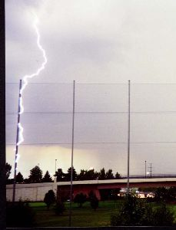
Lightning Facts
Can Heat the Air to 50,000 degrees which is 5 times hotter than the sun.
Lightning can strike the same place multiple times
Lightning can strike up to 10 miles away from the center of the thunderstorm
One of the top three thunderstorm related killers
It is estimated that ~ 400 people are struck each year (10 percent are fatal)

Slide 13
Lightning Hazard Areas
Radio and Radio Equipment (1.2%)
Golf and Trees (1.7%)
Open Fields (45.0%)
Telephone (4.0%)
Farm and Heavy Equipment (5.0%)
Under Trees (23.0%)
Water (13.6%)
Golf (6.5%)
Lightning Casualties In U.S. (1959-1994)
Notes:
These are the activities that have the most lightning casualties associated with them in the U.S. Casualties means both deaths and injuries combined.
We’re going to go through these one by one to show that some school activities can put students at high risk.

Slide 14
Thirty Minute Rule
Competition or practice shall be suspended once lightning has been recognized in the area or thunder is heard. It is mandatory to wait at least 30 minutes after lightning is out of the area or thunder is heard prior to resuming practice or competition. Any subsequent lightning in the area or thunder after the beginning of the 30-minute count shall reset the clock, and another count shall begin.

Slide 15
INCLEMENT WEATHER
If lightning is imminent or a thunderstorm is approaching, all personnel, athletes and spectators shall evacuate to available safe structures or shelters.
If you note that other school events, aside from your game are continuing, notify the nearest athletic administrator. These games are not under your direction.

Slide 16
Safe Locations
10
9
8
7
6
5
4
3
2
1
0
Lightning Certified Facility
Lightning Protected Building
Seek Proper Shelter
Buildings Much Better Than Vehicles
Vehicles Offer Some Safety
No Place Outside Is Safe Near A Thunderstorm
Relative Lightning Protection
Outdoors
Notes:
We talked about going to proper lightning shelters, but what constitutes a proper lightning shelter? Of the resources most commonly available, a large fully enclosed substantially constructed building is your best bet, such as your typical house or school. By substantially constructed, we mean it needs a lot of wiring and plumbing in the walls.
If a building isn’t available,a vehicle with a metal roof and metal sides is a reasonable second choice. Notice how I emphasize it’s the metal shell that protects you, not the rubber tires insulating you from the ground -- that’s a myth that just won’t die!

Slide 17
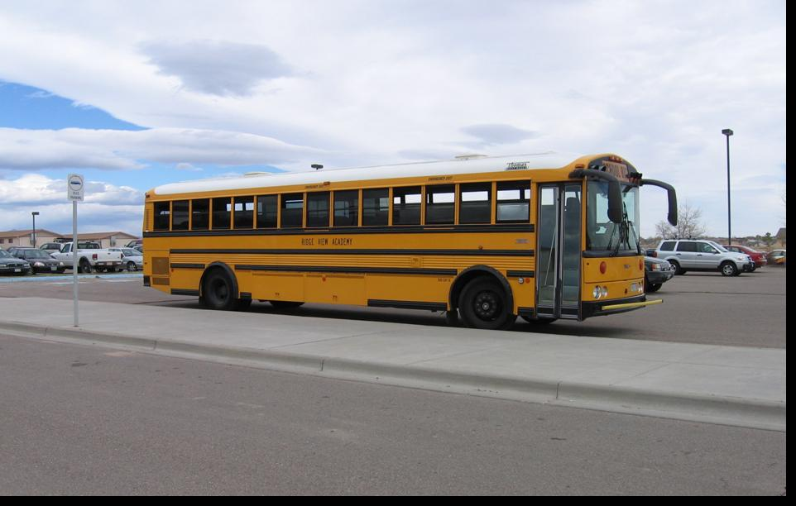
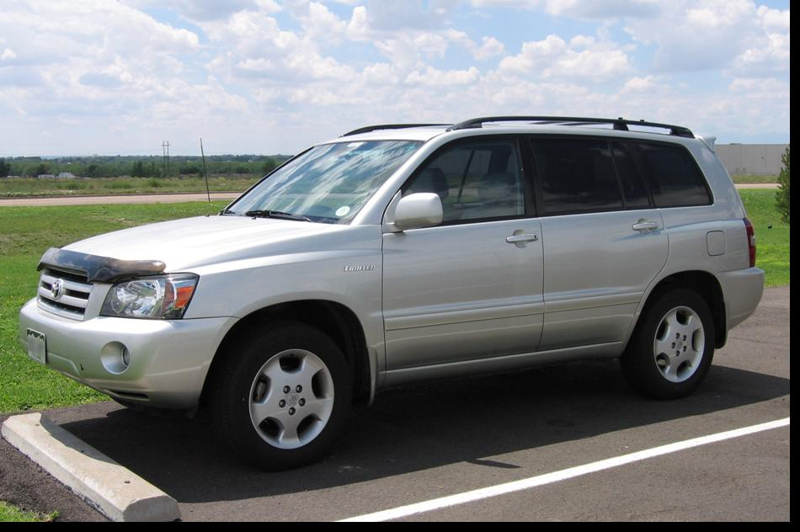
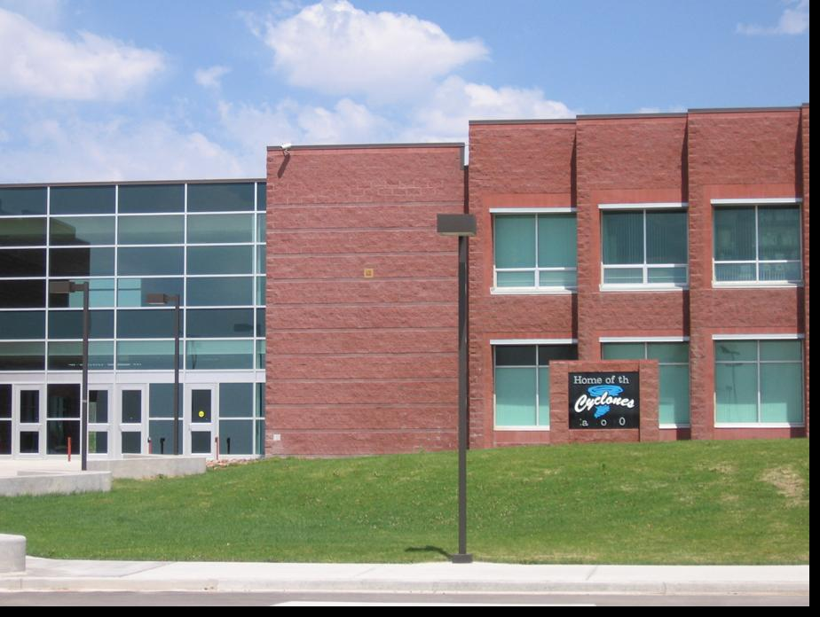
Safe

Slide 18
INCLEMENT WEATHER
REVIEW PRESEASON GUIDE WEATHER-RELATED INFORMATION
THESE RULES MUST BE ENFORCED BY ALL!

Slide 19
CONCUSSION MANAGEMENT
OHSAA has always played key role in developing polices covering all aspects of safety for student- athletes
Ohio law which became effective middle of 2013 season included many OHSAA regulations and added several aspects to previous regulations

Slide 20
CONCUSSION MANAGEMENT
State law regulates some aspects
Return to play has been updated
Contest officials and others are now required to have completed an approved training program in concussion recognition - MUST BE COMPLETED EVERY THREE YEARS
Other portions of the law impact schools, coaches, parents and student athlete participants

Slide 21
CONTEST OFFICIALS REQUIREMENTS
The new legislation provides that no school “shall permit” an individual to referee interscholastic athletic contests unless the individual holds a Pupil Activity Program/Coaching Permit or has successfully completed within the last three years a training program in concussion recognition. Therefore, all OHSAA licensed officials shall possess either a current Department of Education issued Pupil Activity Program/Coaching Permit or show evidence of completing an approved online concussion education course as stipulated by the law.

Slide 22
CONCUSSION MANAGEMENT
This OHSAA regulation, as amended to incorporate this recent legislation, now reads: Any student, while practicing for or competing in an interscholastic contest, who exhibits signs, symptoms or behaviors consistent with having sustained a concussion or head injury (such as loss of consciousness, headache, dizziness, confusion or balance problems) shall be immediately removed from the practice or contest by either of the following: 1) The individual who is serving as the student’s coach during that practice or competition OR 2) An individual who is serving as a contest official or referee during that practice or competition.
Notes:
Comments: Concussion Management – The position of the NFHS Sports Medicine Advisory Committee is that no athlete shall return to play or practice on that same day after suffering a concussion. Studies have shown medical professionals that the school-aged brain does not recover quickly enough for a high school athlete to return to activity in such a short time. No athlete should return-to-sport or other at-risk participation when symptoms of concussion are present and recovery is ongoing. Please see the “NFHS Suggested Guidelines for Management of Concussion” at www.nfhs.org for further information.

Slide 23
RETURN TO PLAY PROTOCOL
If a student is removed from practice or competition due to a suspected concussion or head injury, the coach or referee who removes the student shall not permit the student, ON THE SAME DAY THE STUDENT IS REMOVED, to return to that practice or competition or to participate in any other practice or competition for which the coach or contest official is responsible.

Slide 24
RETURN TO PLAY PROTOCOL
The student athlete can return on a subsequent day after the student’s condition has been assessed by an authorized health care provider and the student receives written authorization from the provider stating that it is safe to return to practice or competition.
This is a school responsibility.

Slide 25
CONCUSSION MANAGEMENT
Remains in ALL NFHS Rules Books
List of Common Symptoms of Concussion
Other information on this page does not reflect Ohio law or OHSAA regulations
Under current Ohio Law officials are no longer involved in handling Medical Authorization to Return to Play Documents. This is now a school responsibility.
Notes:
Comments: A new form has been developed to document when a player, who has been removed due to exhibiting signs, symptoms or behaviors consistent with concussion, has been approved to return to play that day. The form can be found on the OHSAA web site at www.ohsaa.org on both the sports medicine link and the Volleyball page. Officials who have removed a player under this rule shall not permit the player to return to play without this signed form. The official should then make a copy of the form and forward it to the OHSAA office.

Slide 26
CONCUSSION MANAGEMENT
What does this mean to Coaches & Officials?
Coaches and/or Officials are NOT expected to “diagnose” a concussion that is the job of an appropriate health-care professional.
Coaches, Officials AND Administrators ARE all responsible to make all efforts to ensure that concussed athletes do not continue to participate.
Notes:
Neither officials, nor coaches, are expected to DIAGNOSE a concussion; that is the job of an appropriate health-care professional. The previous rule called upon officials to determine “apparently unconscious” which appeared to expect some level of medical judgment. Officials are now being asked to use their best judgment again in observing the signs, symptoms and behaviors, but are no longer being asked to make what could be perceived to be a medical opinion. The well-being of the athlete is of paramount concern during any athletic contest. Officials, coaches and administrators are being asked to make all efforts to ensure that concussed athletes do not continue to participate. Early recognition of concussion and removal of the injured athlete from activity (game or practice) is a shared responsibility. Thus, coaches, players and administrators should also be looking for signs of concussion in all athletes and should immediately remove any suspected concussed athlete from play.

Slide 27
Concussion Recognition and Management Procedures
The Official is NOT RESPONSIBLE for the evaluation or management of the athlete after she is removed from play.
This responsibility rests with school personnel and of course medical professionals
Notes:
Neither officials, nor coaches, are expected to DIAGNOSE a concussion; that is the job of an appropriate health-care professional. The previous rule called upon officials to determine “apparently unconscious” which appeared to expect some level of medical judgment. Officials are now being asked to use their best judgment again in observing the signs, symptoms and behaviors, but are no longer being asked to make what could be perceived to be a medical opinion. The well-being of the athlete is of paramount concern during any athletic contest. Officials, coaches and administrators are being asked to make all efforts to ensure that concussed athletes do not continue to participate. Early recognition of concussion and removal of the injured athlete from activity (game or practice) is a shared responsibility. Thus, coaches, players and administrators should also be looking for signs of concussion in all athletes and should immediately remove any suspected concussed athlete from play.

Slide 28
Concussion Recognition and Management Procedures
No coach or official may permit a removed player to return to competition or practice on the same day the student is removed due to a suspected concussion or head injury.
Notes:
However....and this is they key; ONLY an “appropriate health-care professional” may make the determination that a player may return to play. Ohio has recognized ONLY MDs, DOs and LICENSED athletic trainers as the ONLY ones permitted to grant this return to play.
This approval MUST BE IN WRITING using the OHSAA Return to Play Form!
The COACH CANNOT re-insert a player after being removed by an official WITHOUT a written approval from an M.D., a D.O., or a Licensed Athletic Trainer.
Schools are encouraged to develop a protocol regarding this. It may be common for a team physician to be present at a VARSITY/JV Contest....but not at a freshmen or Junior High game. Schools should address this to answer the question of whether or not a parent, who might be a physician has the right to come out of the stands and provide written approval to return to play when the physician may not be the schools’ Board adopted Team Physician. WHEN IN DOUBT...SIT ‘EM OUT!

Slide 29
CONCUSSION REPORT
Found at www.ohsaa.org – Sports Medicine and Softball
OHSAA CONCUSSION REPORT – Send to Andrea Heiberger - OHSAA office - aheiberger@ohsaa.org
MEDICAL AUTHORIZATION TO RETURN TO PLAY – Not used by officials at this time.
Notes:
A copy of all concussion forms can be found on the OHSAA web site on the Softball
Page and on the Sports Medicine Page
The form to use when a student has been sent out due to an official’s recognition of the signs and symptoms of a possible concussion to authorize RTP by an MD, DO or AT is found here on both the sports medicine and softball pages. It is entitled “Documentation of a Removal from Play for Concussion Management”
The form that the official must file when a student has been removed for signs of a concussion and has not been returned to play is also found here at both sites and is entitled: Medical Authorization to Return to Play- Not Concussed”
Note that the official should keep a copy of both forms for his/her records and send the original to the OHSAA.

Slide 30
CONCUSSION MANAGEMENT
If a contest official is aware that a student has been permitted to return to competition on the same day as removal, that official shall immediately stop play and remove that student from competition and report the incident to the OHSAA.

Slide 31
Concussion in Sports – Every 3 years www.nfhslearn.com
Notes:
To assist in concussion management education, the NFHS, at no cost, offers Concussion in Sports - What You Need to Know.
The only requirement is registering on www.nfhslearn.com, which is quick and easy.
This 20 minute course is designed for coaches, officials, parents, administrators and students to learn how to recognize the signs and symptoms of concussions and a step-wise process to return to the sport.
Check it out and share this information with others. Approximately 155,000 courses have already been delivered!

Slide 32
OHSAA ADOPTIONS- GAME ENDING PROCEDURES - REGULAR SEASON
BEYOND 5 INNINGS COMPLETE
GAMES HALTED EARLIER ARE SUSPENDED
EXCEPTIONS ARE TIES & WHEN VISITORS HAVE TIED/TAKEN LEAD AND INNING IS NOT COMPLETED
GAMES CAN NEVER BE “STARTED OVER”
EXAMPLES – PRESEASON GUIDE
TEN RUN RULE
MUTUAL CONSENT
IMPACT ON GAMES LIMITATION

Slide 33
OHSAA ADOPTIONS- GAME ENDING PROCEDURES - TOURNAMENT
OHSAA TOURNAMENT GAMES
PLAYED TO COMPLETION
INCLUDES --
BB RULE 4-2-4 AND SB RULE 4-2-3
TEN RUN RULE

Slide 34
UMPIRE CONDUCT
OFFICIALS PLAY A ROLE JUST AS DO ALL PARTICIPANTS
YOU SERVE AS A ROLE MODEL
RESPECT THE GAME

Slide 35
EJECTIONS
REMINDER
WHEN EJECTIONS HAPPENS
PHONE CALL REQUIRED
ONLINE REPORT MUST BE SUBMITTED – OFFICIALS PORTAL
IF COACH EJECTED
$100.00 FINE
ONLINE COURSE MUST BE TAKEN
ONLINE COURSE THROUGH NFHS
FEE FOR ONLINE COURSE
TWO GAME SUSPENSION
Notes:
WHEN A COACH OR STUDENT-ATHLETE IS EJECTED FROM A CONTEST AN OFFICIAL’S REPORT MUST BE FILED WITH THE MEMBER SCHOOL AND OHSAA.
PLEASE NOTE THE DIFFERENCE BETWEEN EJECTIONS FOR UNSPORTING CONDUCT AND “RESTRICTION TO THE BENCH” AS INDICATED IN THE PLAYING RULES FOR SOFTBALL.
REMEMBER TO “RESPECT THE GAME”

Slide 36
OHSAA Rules Affecting Ejections
Decisions of ALL Officials are FINAL
After an Ejection:
Bylaw 8-3
COACHES
LEAVE the Facility
Ineligible for all remaining play that day
Ineligible for next TWO matches
May not travel to or sit with team
Pays $100.00 Fine
Completes NFHS Course –
Teaching and Modeling Behavior
PLAYERS
Remain supervised in Bench area
Ineligible for all remaining play that day
Ineligible for next TWO contests
May not travel to or sit with team
Notes:
Just a quick reminder, the decisions of officials are final as per OHSAA bylaw and NFHS rules. VB playing rule 12-2 prescribes the protocol for dealing with misconduct.
This slide is a review of the procedures for both player and coach ejections. Players must remain supervised in the bench area and will miss the remainder of all contests on the day of the ejection plus the next two matches. While ejected they may not travel with or sit with the team. For coaches, they must leave the facility and are also denied participation for the rest of the that day and for the next two matches at the same level as the ejection. In addition, coaches must pay $100 and complete the Teaching and Modeling Behavior Course at www.nfhslearn.com. Officials are required to report all ejections to the office using the procedure found on myohsaa.

Slide 37
SPORTING CONDUCT
Bench Restrictions should be used where appropriate
Example – Use of Electronic Devices on Field
Rule 3 covers when Ejection, Bench Restriction, or Discretion is applicable
Both coaches and players (Softball only) can be restricted to the bench

Slide 38
UMPIRE JURISDICTION
NFHS-RULE 10 …
UMPIRE JURISDICTION BEGINS UPON THE ARRIVAL OF ONE UMPIRE WITHIN THE CONFINES OF THE FIELD AND ENDS WHEN THE UMPIRES LEAVE THE FIELD OF PLAY AT THE CONCLUSION OF THE GAME.

Slide 39
UMPIRE JURISDICTION
ANY UMPIRE’S DECISION WHICH INVOLVES JUDGEMENT, SUCH AS WHETHER A HIT IS FAIR OR FOUL, WHETHER A PITCH IS A STRIKE OR A BALL, OR WHETHER A RUNNER IS SAFE OR OUT, IS FINAL.

Slide 40
OHSAA Officials Insurance
General Liability
Participant Accident Benefits
https://ohsaaweb.blob.core.windows.net/files/Officiating/forms/OfficialsBenefitSummary.pdf
Claims & Questions • Report claims to Hylant, 565 Metro Place South., Suite 450, Dublin, OH, 43017 to the attention of Cathy Noskowiak. Claims can also be emailed to cathy.noskowiak@hylant.com • For questionsregarding this summary, please contact Phil Hein at Hylant at 614-932-1265

Slide 41
OHSAA Officiating Regulations
Only Class One officials are permitted for varsity regular season games
Class Two officials will work only sub-varsity games
Advancement Process – through local association

Slide 42
Assignments/Conflicts
Handling Conflicts of Interest
Avoid These!
Key is PERCEPTION
Be aware of possible issues
Work with Assigners
Assigners know to switch officials to another contest and will work with you

Slide 43
TOURNAMENT SELECTION
Based on process described on OHSAA website – Officiating Page
Input from many sources
Data gathered is used for the ensuing season
Participate in Local Association Selection Process

Slide 44
TOURNAMENT SELECTION
OHSAA office selects/assigns state and regional officials from pools
District Athletic Boards handle District and Sectional Tournaments based on pools developed by OHSAA

Slide 45
Tournament Officials Rating and Voting System
For the sports of:
Baseball
Basketball
Football
Soccer
Softball
Volleyball
Wrestling

Slide 46
Rating & Voting Points System Overview
Coaches
School Vote
Local Associations
Officiating Leaders
Total Points Possible
15
Points
15
Points
15
Points
15
Points
60
Points

Slide 47
Coaches
Continue to rate officials on a 1-5 scale
Only rated on Varsity contests
If an official receives fewer than 15 ratings, the official will receive a rating of 2.5 for each rating fewer than 15

Slide 48
Coaches
The official’s highest three (3) and lowest five (5) ratings will be deleted
The remaining ratings would be used to calculate the official’s:
1) Mean (average)
2) Median (middle number)
3) Mode (most frequent)
Those three measures will be totaled for a possible maximum of 15.

Slide 49
School Vote
Athletic Directors are responsible for submitting the ballot, preferably after consulting with their coach.
Continue to vote for a maximum of 15 officials.
The maximum number of votes an official could receive from the School vote is capped at 15.

Slide 50
Local Associations
Associations will vote for 30% of their membership.
The 20% will be divided into 5 groups, each containing 6%.
Group 5 (highest) will receive 15 votes.
Group 4 – 12 votes, Group 3 – 9 votes, Group 2 – 6 votes, & Group 1 – 3 votes.

Slide 51
Local Associations
The selection of officials will be determined by a vote of all members, including class 2 officials.
All class 1 officials will be eligible for consideration and may not be excluded for any reason (except if they voluntarily withdraw).
Officials will not be voted for by position.

Slide 52
Local Associations
An official belonging to more than one Association would be eligible for consideration from all Associations in which a member, but receives the vote only from the Association in which the official ranked highest.
The selection procedure must be conducted in an open and transparent fashion.

Slide 53
Local Associations
Selection results must be made available to all Association members.
The OHSAA may direct a District Administrator to conduct an Association’s selection procedure if the Assistant Commissioner determines it necessary.

Slide 54
Officiating Leaders
Includes:
Local Association Secretaries
Local Association Interpreters
Assigners
Current Instructors
Directors of Officiating Development (DODS)
OHSAA Administrators
OHSAA-assigned Tournament Observers
Others as determined by the OHSAA

Slide 55
Officiating Leaders
Local Association Secretaries
Vote for 25% of their Association membership and may vote for officials outside of their Association.
Local Association Interpreters
Vote for 25% of their Association membership and may vote for officials outside of their Association.

Slide 56
Officiating Leaders
Assigners (of Varsity Sports)
Must have an evaluation/observation program in place.
Vote for 25% of the number of varsity officials they assign.
Vote on a 3-point scale, with 1 being the lowest and 3 being the highest.
Current Instructors
Vote for 30 officials in the sport they teach.

Slide 57
Officiating Leaders
DODs, OHSAA Staff
Vote on a 5 point scale with 5 being the highest
Others selected by OHSAA
Vote for a maximum of 30 officials
Would include approved observers

Slide 58
Ranking and Pools (1 of 4)
Officials will be ranked in their Athletic District of residence from highest to lowest.
Ranked officials will then be divided into pools.
Pools are groups of officials eligible for various levels of the tournaments.

Slide 59
Ranking and Pools (2 of 4)
The District and Sectional pool will be approximately twice as large as the number of officials to be assigned.
The Regional pool will be approximately 2.5 times the number of officials needed.
The State pool will be approximately three times the number of officials needed.

Slide 60
Ranking and Pools (3 of 4)
Tournament eligible officials complete a tournament questionnaire through their myOHSAA account.
Upon completion of the questionnaire process, the rankings and pools are reviewed to make certain there are enough officials in each pool.

Slide 61
Ranking and Pools (4 of 4)
Regional and State assignments are finalized by one or more individuals, including DODs and OHSAA staff.
District and Sectional assignments are finalized through District Athletic Boards (DAB). DABs receive lists of officials receiving a State and Regional assignment.
Officials may be divided into District, Sectional, or Alternate pools to facilitate assigning.

Slide 62
Frequently Asked Questions
Q: What if I hold multiple positions in this system? I am a Secretary, Assigner, and an Instructor.
A: You must choose one role.
Q: Why are the highest three (3) and lowest five (5) coaches ratings dropped from the coaches vote metrics?
A: By dropping those ratings, the metrics are a truer reflection of the official’s performance. This prevents an official’s average from being affected by an emotional rating from a coach.

