Slide 1
OHSAA Four Umpire Mechanics

Slide 2
Four Umpire System
Prerequisites
Knowledge of 2 and 3-umpire mechanics
Communication
Responsible for all plays at your assigned base
Exception: When an umpire chases
One umpire chases on every fly ball and line drive into outfield
Understanding of Rotation vs. Lateral coverage

Slide 3
Starting Positions
The U1 and U3 start in foul territory about a foot from the four line.
No Runners: U1 and U3 are positioned 18-21 feet from the base and take a step or two with the release of the pitch.
Base Runners: U1 and U3 start in the ready or set position, 12-15 feet from the base.
U2: U2 starts in the ready or set position 18 feet from 2B with no runners, 12-15 feet with runners, on the 3rd to 2nd base line extended.
Whenever there is a runner on 2B, U2 starts in the ready position 12-15 feet from 2B on the 1st to 2nd base line extended.
U2
U3
18-21’
12-15”
12-15”
2U
2U
18-21’
12-15”
P
18-21’
12-15”
U1

Slide 4
Plays from the Infield
Base umpires move to get into calling positions at their assigned bases.
Force Plays: Base umpires should be no closer that 18 feet and strive for a 90-degree angle to the throw.
Tag Plays: Base umpires should try to close to 10-12 feet from the play and strive for a 90-degree angle to the runner’s approach to the base.
PU: The plate umpire trails the batter-runner with no runners or a runner on 1B only; in other instances, the plate umpire stays home.
U3
U2
P
P
P
U1

Slide 5
Plays from the Outfield—No Umpire Chase
Base umpires pivot inside the diamond to get into calling positions at their assigned bases.
Pivots should be 10-12 feet inside the baseline.
Calling position is 90 degrees to the runner’s approach to the base or tag.
PU moves to observe the play and get into a calling position at the plate.
U3
U2
P
P
U1

Slide 6
Rotate – Lateral Coverages
When an umpire chases to make a call in the outfield, the remaining three umpires move to cover the open base.
Rotate: When there are no runners or a runner at 1B only, the remaining umpires will rotate clockwise (opposite direction of the runners).
Lateral: Whenever there is a runner in scoring position (2B, 3B, 2B & 3B), the remaining umpires will move in a lateral coverage.

Slide 7
Rotation Coverage
U1 Chases
Base umpires pivot inside the diamond to get into calling positions at their assigned bases.
U2 pivots and takes calls at 1B, watching for obstruction, is responsible for the tag-up of the runner at 1B.
U3 pivots to a calling position at 2B.
PU moves to a calling position at 3B.
U2 moves to a calling position at the plate.
U3 becomes responsible for 2B and 1B.
U3
U2
P
U1

Slide 8
Rotation Coverage
U2 Chases
Base umpires pivot inside the diamond to get into calling positions at their assigned bases.
U1 pivots and takes calls at 1B, watching for obstruction, is responsible for the tag-up at 1B.
U3 pivots to a calling position at 2B. When batter-runner reaches 1B, U2 moves to watch 1B and 2B.
PU moves to calling position at 3B.
U1 moves to a calling position at the plate.
U3 becomes responsible for 1B and 2B.
U3
U2
P
U1

Slide 9
Rotation Coverage
U3 Chases
Base umpires pivot inside the diamond to get into calling positions at their assigned bases.
U1 pivots and takes calls at 1B, watching for obstruction, is responsible for the tag-up at 1B.
U2 pivots to a calling position at 2B.
PU moves to calling position at 3B.
U1 moves to a calling position at the plate.
U2 becomes responsible for 1B and 2B
U3
U2
P
U1

Slide 10
Lateral Coverage
Lateral Coverage differs. When runners are in scoring position, the PU is never involved in coverage of another base due to the importance of making a crucial call on a play at the plate.
U3 Chase: U2 pivots and moves directly to a calling position at 3B. U1 is responsible for all plays at 1B and 2B.
U1 or U2 Chase: The remaining umpire pivots and is responsible for all plays at 1B and 2B.

Slide 11
Lateral Coverage
U1 Chases
Base umpires pivot inside the diamond to get into calling positions at their assigned bases.
U2 pivots and takes calls at 1B and 2B, including tag-ups at both bases.
U3 pivots to a calling position at 3B and is responsible for the tag-up of the runner on 3B.
PU moves to a calling position at the plate.
U3
U2
R
P
U1

Slide 12
Lateral Coverage
U2 Chases
Base umpires pivot inside the diamond to get into calling positions at their assigned bases.
U1 pivots and takes calls at 1B and 2B, including the tag-ups on both bases.
U3 pivots to a calling position at 3B and is responsible for the tag-up on the runner at 3B.
PU moves to a calling position at the plate.
U2
U3
R
P
U1

Slide 13
Lateral Coverage
U3 Chases
Base umpires pivot inside the diamond to get into calling positions at their assigned bases.
U2 pivots directly to a calling position at 3B and has the tag-up on the runner at 3B.
U1 pivots and takes calls at 1B and 2B, including tag-ups of runners on those bases.
PU moves to a calling position at the plate.
U3
U2
R
P
U1

Slide 14
Rotation/Lateral Coverage
Study these and commit to memory
No deviations
Understand tagup and base touch duties
Pre-pitch Planning & Constant Concentration
Communication – Two Ways
Prior to play – signals
During play – talk!

Slide 15
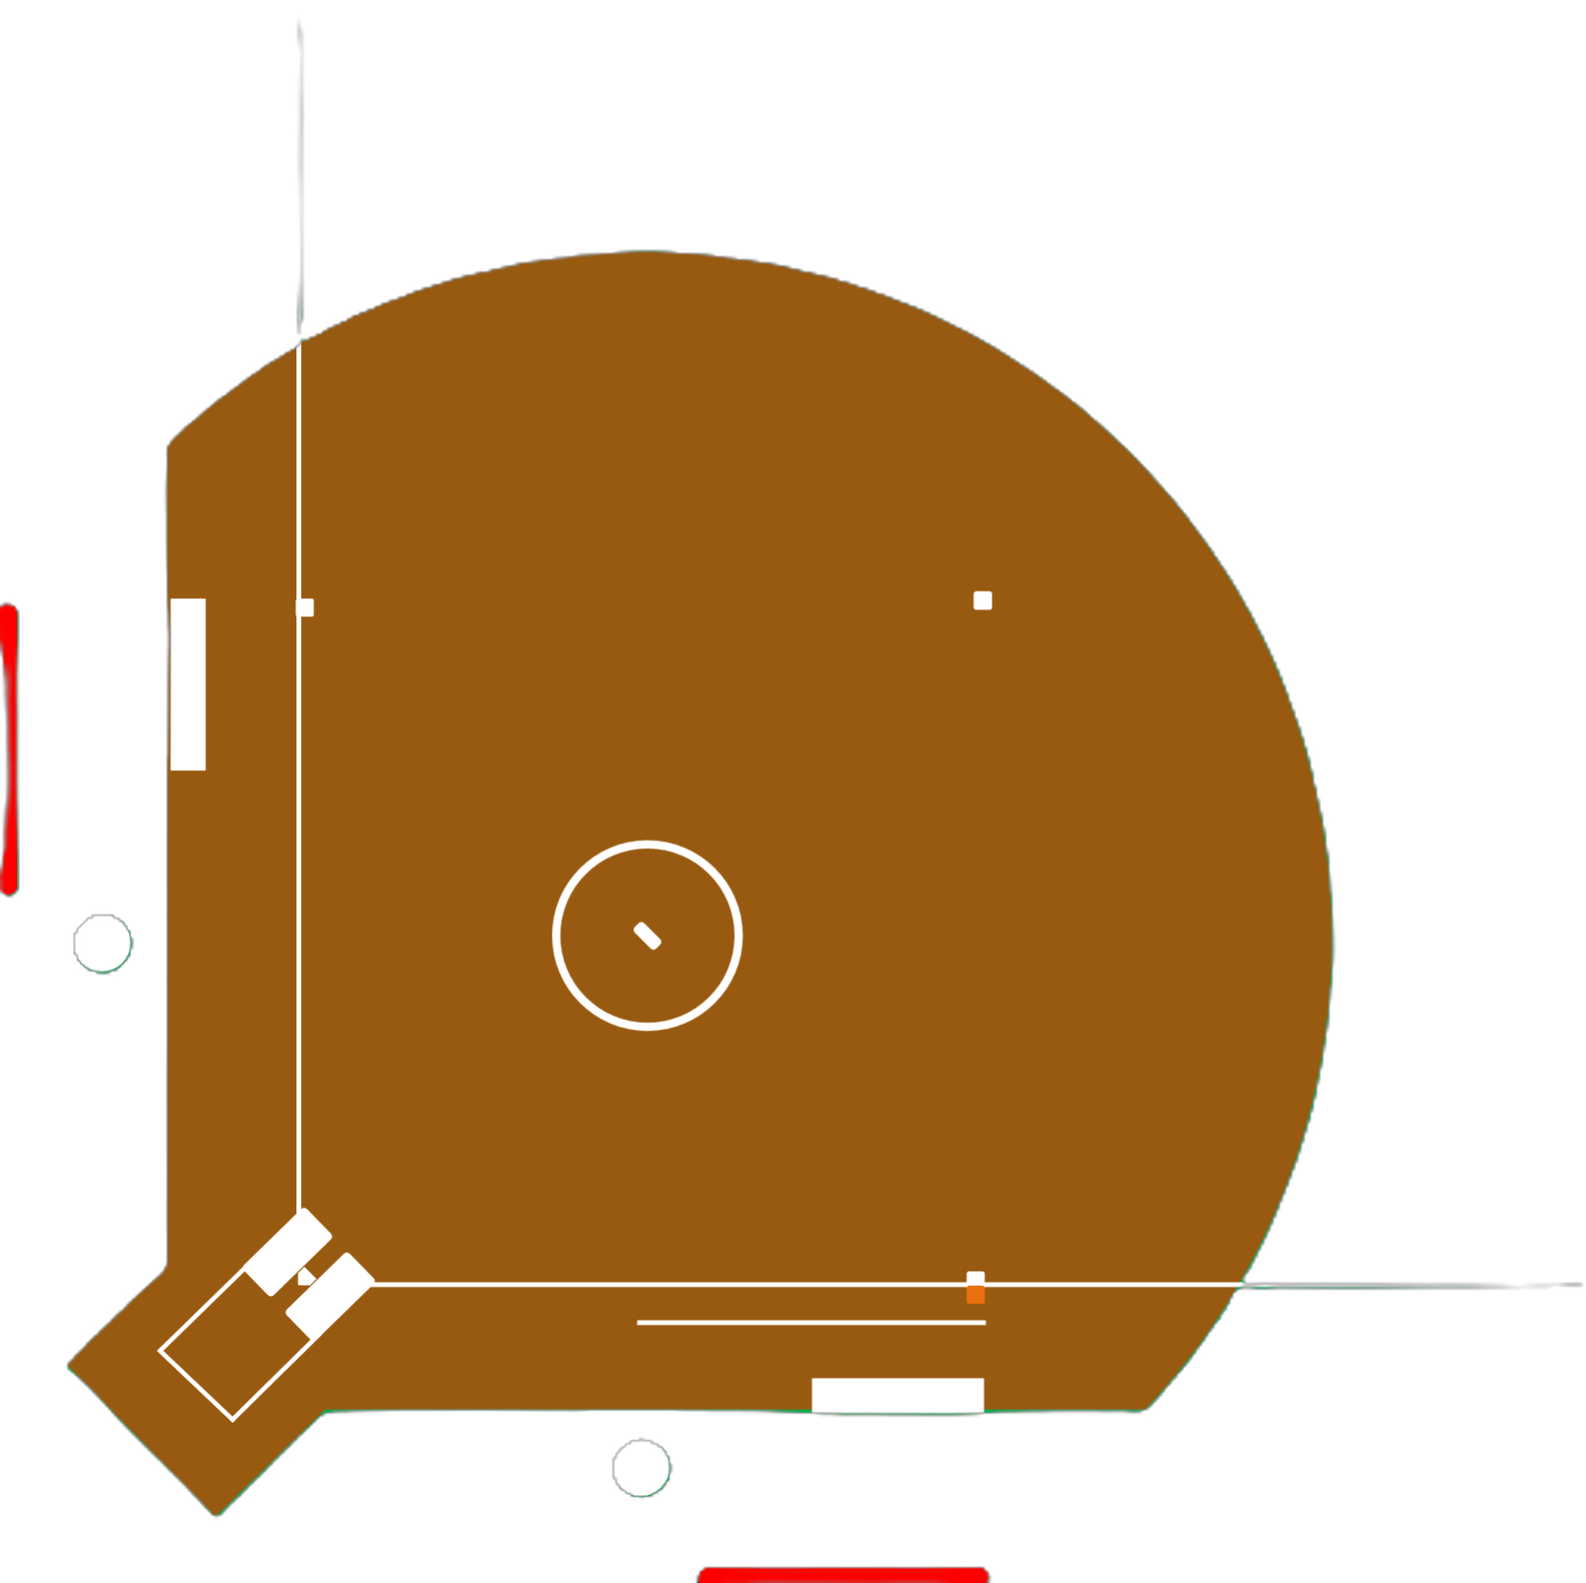
F7
F8
Chase Responsibilities
These do not change regardless of the position of U2
U1—from F9 to dead ball territory. Makes fair/foul calls on balls near the line.
U3—from F7 to dead ball territory. Makes fair/foul calls on balls near the line.
U2—from F7 to F9
PU—everything in front of the base umpires
No chase on ground balls through infield.
U3
U2
F9
P
U1

Slide 16
The Art of the Chase
U2 should read whether U1 or U3 is chasing on balls hit directly to fielder.
Don’t run directly at the fielder—create an angle to the flight of the ball and the catch.
Stay at least 15 feet from the fielder.
If the ball is near the foul line, chase on the foul line to make fair/foul call as well as catch.
Stop before the catch is made—be stationary for the catch.
Use out signal. Only use safe signal when ball is trapped or bobbled/not controlled.
Turn with the throw of the ball to the infield and watch play; do not return to infield until after play.
Balls near foul line: Straddle the line and watch into deadball boundary.
Give status (fair/foul) when first touched, then rule on catch.

Slide 17
Miscellaneous
Between inning positions:
U1 and U3—15 feet from foul lines, in the outfield area
U2—in the outfield area beyond 2B, toward the left of 2B
Umpire not involved in a chase closest to the circle when the third out occurs should clean the plate. (Note – Turf Fields)
Checked swing—always the umpire on the line opposite the batter.
U3—left handed batter.
U1—right handed batter.
Fair and Foul Responsibilities
When the need arises to confer with another umpire, involve all four umpires.

Slide 18
Tag-up Responsibilities
1U
1B
2B and 1B when U3 chases
3U
3B
2B and 1B when U1 chases
Plate
3B when U3 chases, or U1 chases with runner on 3B
Lateral Coverage
No umpire chases | All pivot to watch runner at their bases
U1 Chases | U2—1B and 2B | U3—3B
U2 Chases | U1—1B and 2B | U3—3B
U3 Chases | U1—1B and 2B | U2—3B
Rotate Coverage
U1 Chases | U2—1B
U2 or U3 Chase, no chase | U1—1B

Slide 19
Pregame Conference – Plate Umpire Arrive minimum of one hour early NFHS Manual – Pages 19 Uniforms – Look great! Pants Color Bring Equipment Publications Bat List Everyone owns the rules
Reminders

Slide 20
Pregame Meeting
Plate Umpire
Introductions
Verify legally equipped
Sporting Behavior
Changes through you
Ground Rules

Slide 21
Signal PB with a wave Point to change Record on lineup card Notify opponent If complicated tell the admin table and info can be relayed to PB
Substitutions

Slide 22
QUESTIONS

Slide 23
THANKS AND HAVE A GREAT TOURNAMENT

