Slide 1
ArbiterGame How-To Guide
An overview of how to complete various actions throughout the arbitergame software

Slide 2
Settings
Very last tab in the top row after logging into your school’s account
Where you will make any edits to school’s information, update preferences and choose to publish games to ArbiterLive

Slide 3
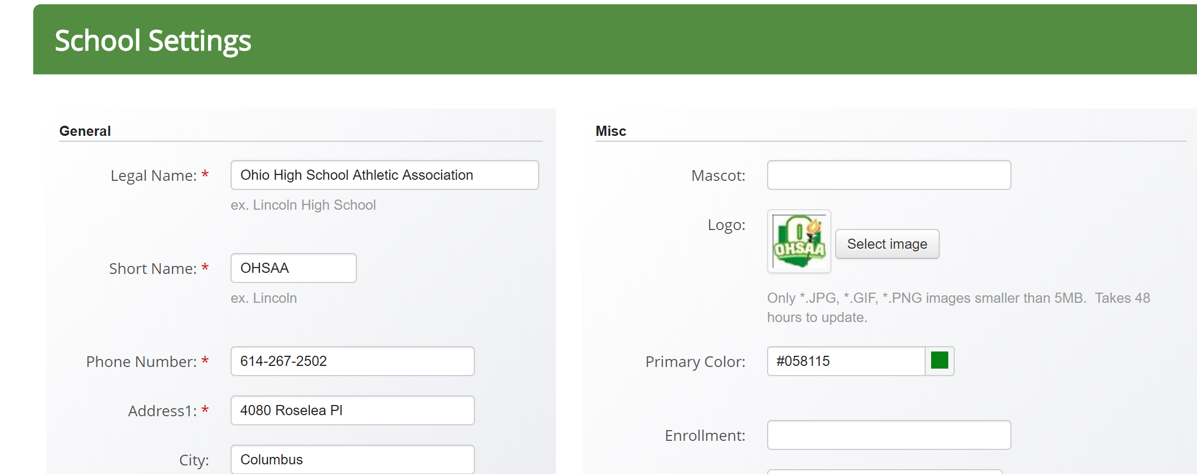
Settings – School
Landing page of the settings tab
Where school information is kept up to date
Section should be completed as accounts are 5 years old
Make sure a logo is uploaded; this lets others know the account is active

Slide 4
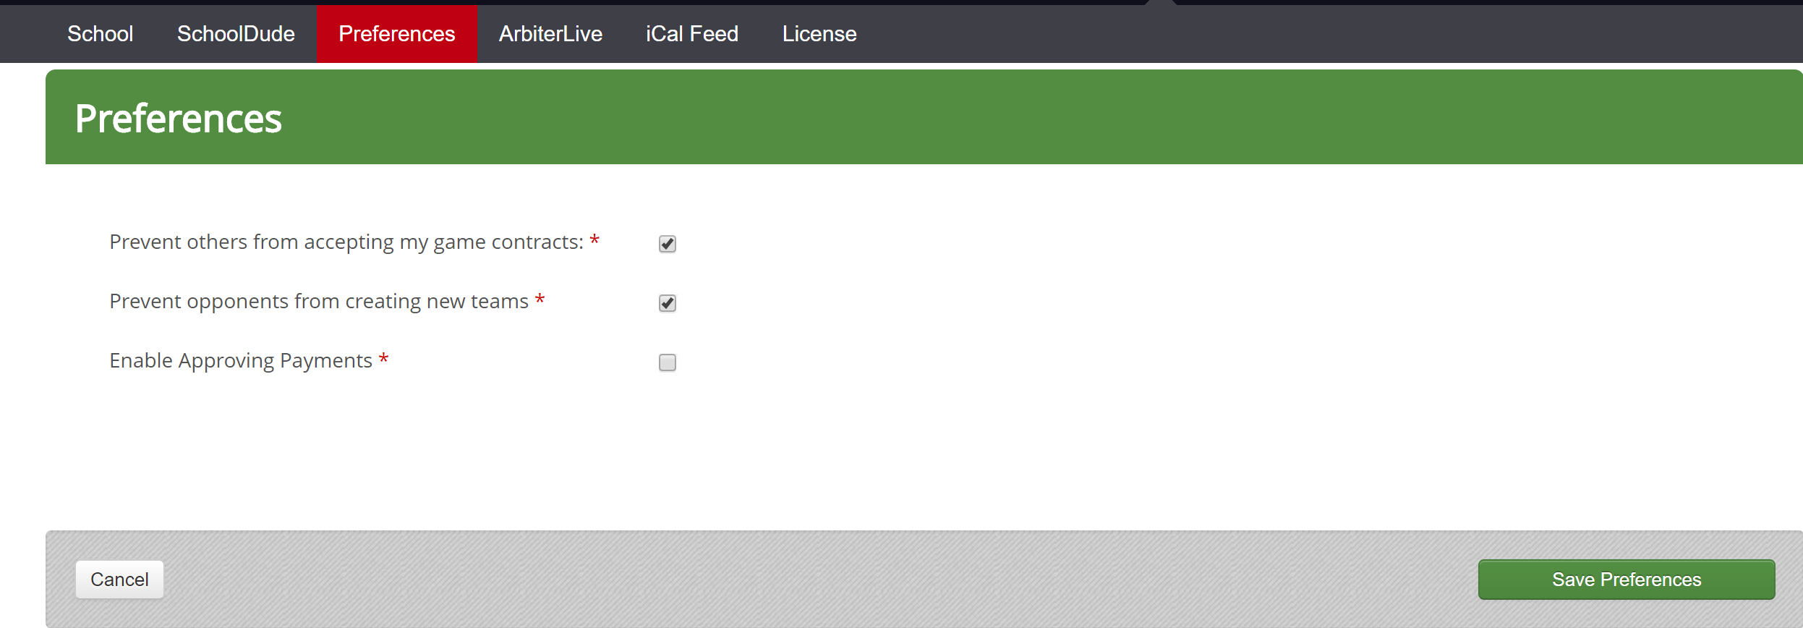
Settings – Preferences
Ensure the top box is checked
Disables the ability for opponents to accept the contract on your behalf
Second box prevents opponents from creating new teams for your school
Third box allows for an additional layer of approval when paying through ArbiterPay

Slide 5
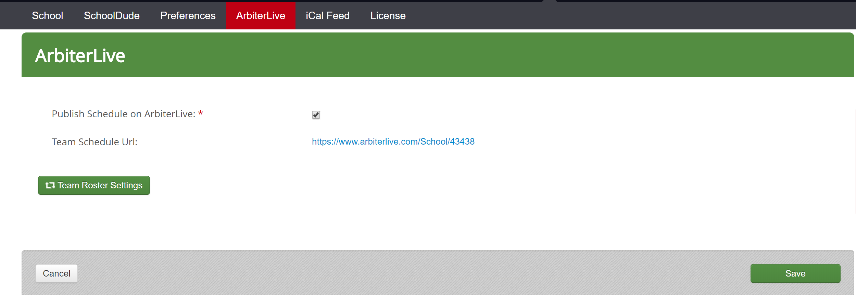
Settings – ArbiterLive
Allows Admins to choose whether or not a schedule will be published to the ArbiterLive website for public view
Tab also provides the URL unique to the school
This can be provided to whomever may need it to view schedules
Schedules can also be accessed through the OHSAA online directory
‘Team Roster Settings’ gives Admins choice of which teams would be viewable through ArbiterLive

Slide 6
People
The People Tab is where you can add Staff Members at your school, Game Day Workers, Officials and create and modify roles.

Slide 7
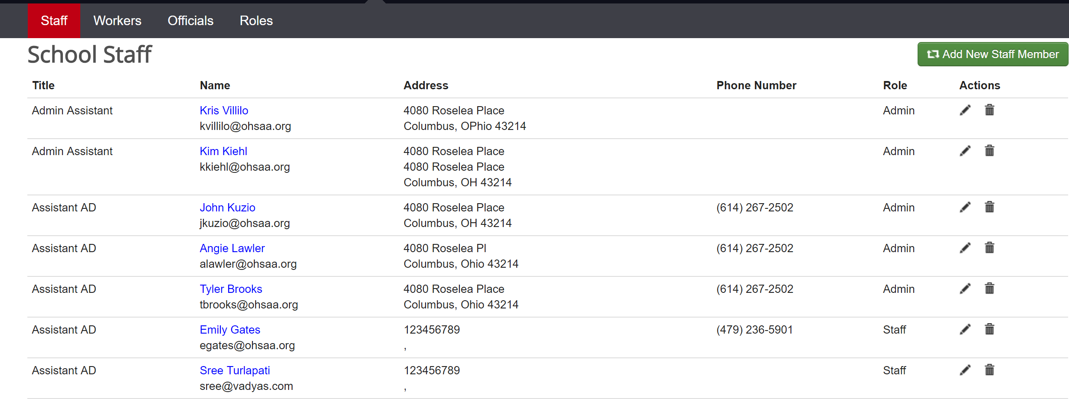
People – Staff
Members of the department can be listed within the staff section
Those who will need to make edits will need to be listed as Admins
Ensure only those who need to make edits are listed as Admins
Others may be listed as Staff or Payor

Slide 8
People – Staff
To add new staff member, select the green ‘Add New Staff Member’ button in the upper right corner

Slide 9
People – Staff
Will be prompted to enter email
Personal information will then be required in order to create the account
The information will auto-populate if the individual already has an account

Slide 10
People – Roles
Allows for Admins to restrict and expand access for those listed as ‘Payor’ or ‘Staff’
Payor - Members of this role have access to make payments. This role can be edited to fit your needs
Staff - Members of this role have limited access. This role can be edited to fit your needs
Click the pencil on the righthand side to make edits to their access

Slide 11
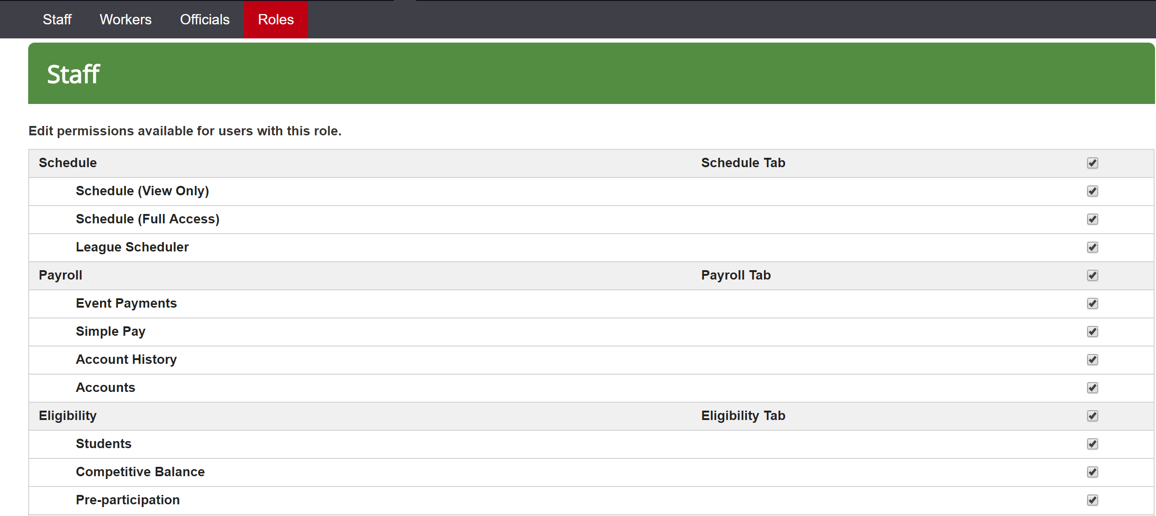
People – Roles
Use the check boxes to select the access you want ‘Staff’ and ‘Payors’ to have

Slide 12
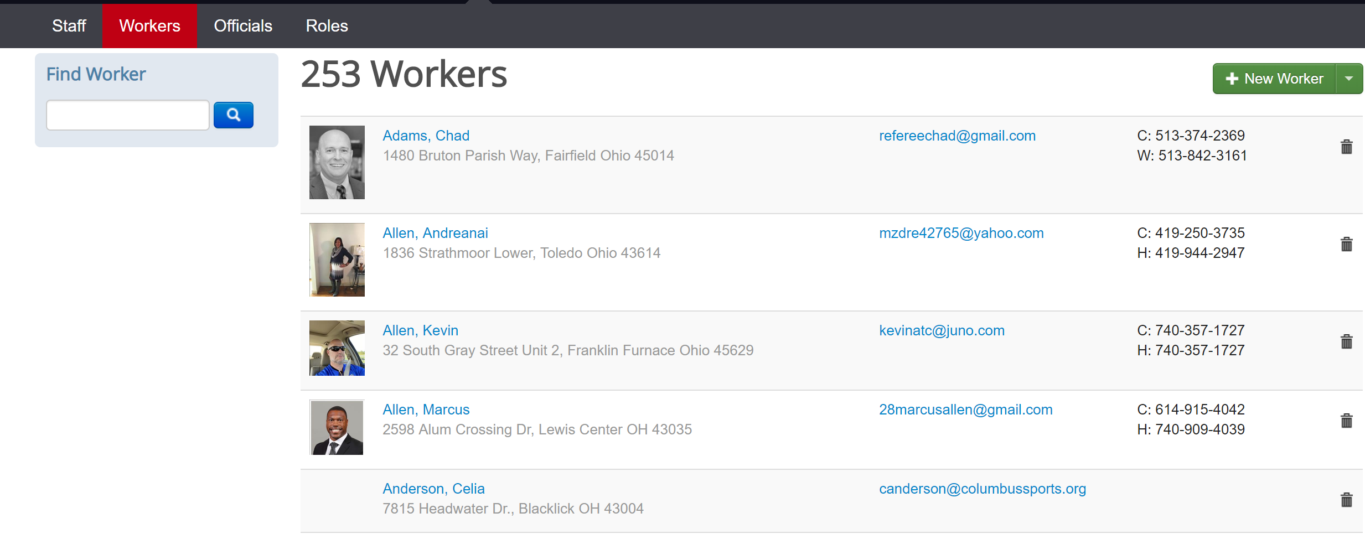
People - Workers
Where you will add staff that work your events and contests
Use the ‘+ Add Event Worker(s)’ button to add new staff

Slide 13
People - Workers
Input email of the new worker, then fill in those fields marked with an asterisk
Click ‘Create New Worker’ to finish

Slide 14
Resources - Sites
Landing page lists satellite sites and campus site(s)
Satellite sites are places not on the school campus that teams will play home contests
Campus site includes sub sites that are typically the school’s facilities (i.e. gymnasium, football field, softball field, etc.)
Majority of these should be set up already

Slide 15
Sites – Manage Satellite Sites
Add satellite sites by selecting the ‘Manage Satellite Sites’ button in the upper right hand corner
Remove satellite site by selecting the trash can logo to the right of the site
Campus sites cannot be removed

Slide 16
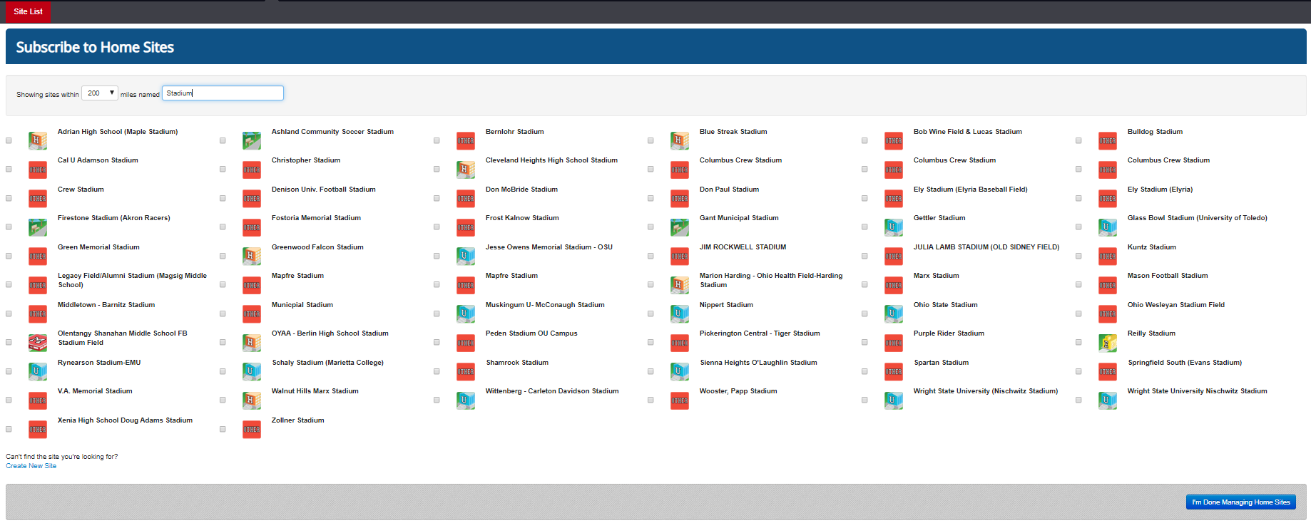
Sites – Adding Satellite Sites
Will need to search with mile range and name of the venue
May also use just the mileage piece and see each venue in that radius
Use check boxes to select the sites that need to be added

Slide 17
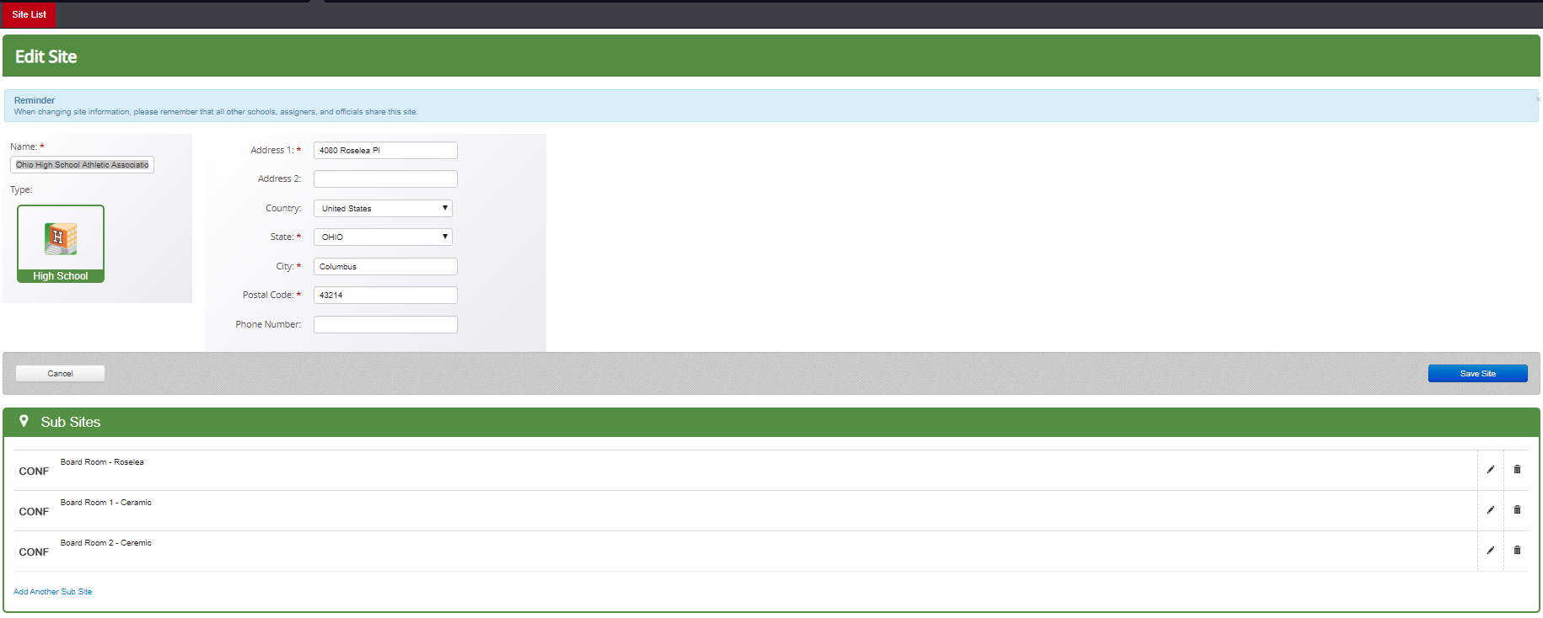
Sites – Campus Site
Selecting the campus site will show the school’s information as well as a list of the subsites/facilities located on the campus

Slide 18
Sites – Edit Sub Site
Select the pencil to the right of the sub site to edit
Name: Name of the sub site that is being edited
May be changed if a renaming occurs for any reason
Type: Select the type of facility this is from the drop down
Supported Sports: Any sport that will be using the facility will need to be listed here
If the sport is not listed, it will not be able to be scheduled at that facility
See additional photos on the next slide

Slide 19
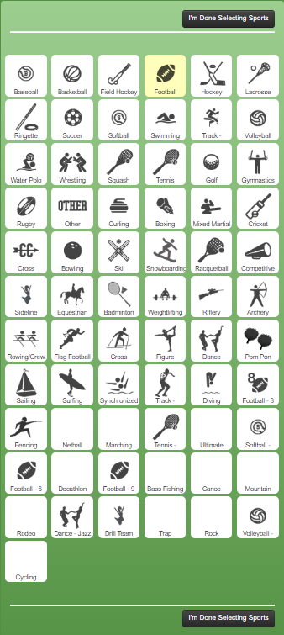
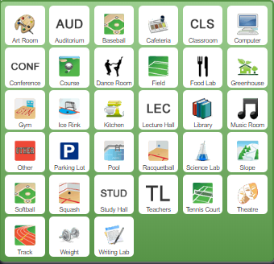
Sites – Edit Sub Site
Type of Subsite:
Supported Sports:
Must select each one by one
Yellow means selected; white means not selected

Slide 20
Sites – Add Sub Site
Add a subsite by selecting the ‘Add Another Sub Site’ link in the bottom left corner of the Sub Sites section

Slide 21
Sites – Add Sub Site
Adding a sub site looks just like the edit sub site section
Add name, select the type and select the supported sports
Click ‘Create Sub Site’ to finish

Slide 22
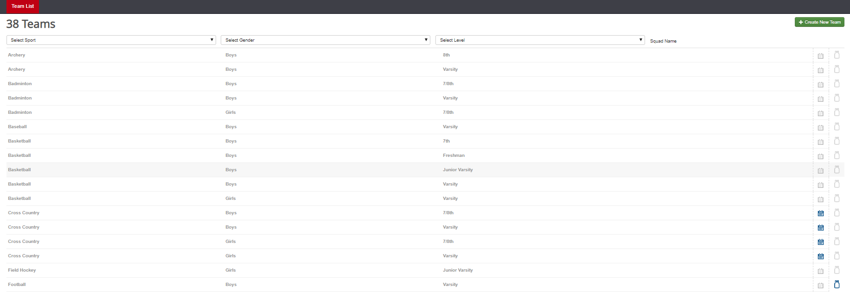
Teams
Landing page will list each team the school has
Three columns listing sport, gender and level
Page can be filtered by each of these
The calendar icon indicates events are present for that team; jersey icon indicates students are placed on that team

Slide 23
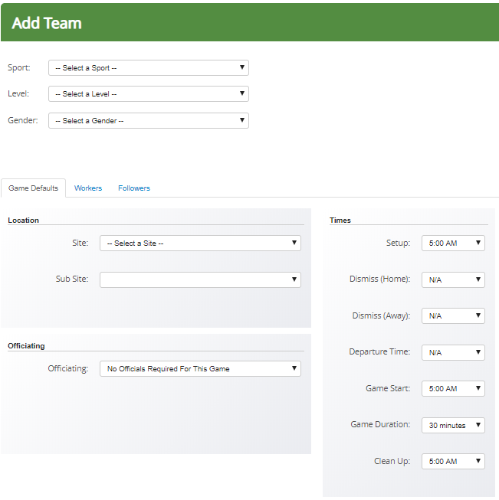
Teams – Create New
Select the ‘+ Create New Team’ button in the upper right-hand corner of the ‘Teams’ page
Select the sport, level and gender of the team being created
Set the defaults just as one would when editing the team

Slide 24
Teams – Edit Team
Clicking on a team will bring up the ‘Edit Team’ page
Not able to change the sport, level or gender of the team; must create a new team if a new level, gender or sport is needed
Game Defaults, Roster and Smart Scheduler are sections that will be edited through this page
Game Defaults: Allows for locations, times and assigners to automatically default when creating a game for that team
Roster: Provides information on and ability to edit the students competing on the specific team selected
Smart Scheduler: Creates parameters for additional games to be created after finishing one
Example: After finishing a Varsity game, a JV game will also be created for a specific time and place between the same schools
Teams can only be deleted if there are no events scheduled for that team

Slide 25
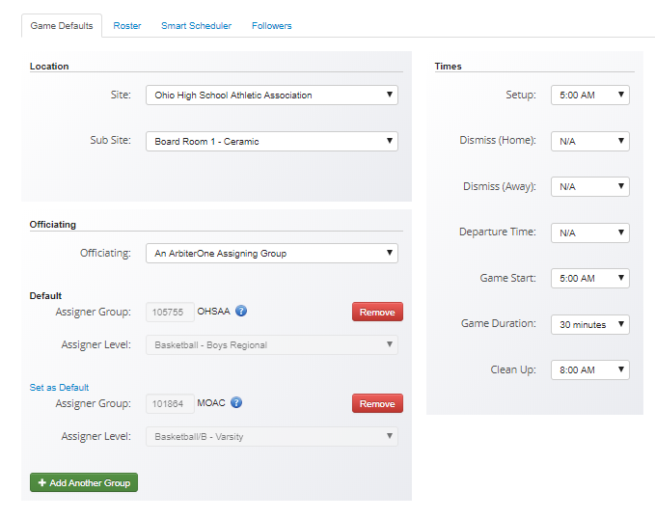
Edit Team – Game Defaults
Location: A new game will default to a site that is selected
Can choose between a satellite site or campus/sub site
Officiating: This is where assigning groups must be added; will need the assigning group number in order to add a group
Will need to add all that will assign for the specific team; will be required to set a default
Times: This will default the setup time, start time, game duration, clean up time and times for travel purposes when creating game

Slide 26
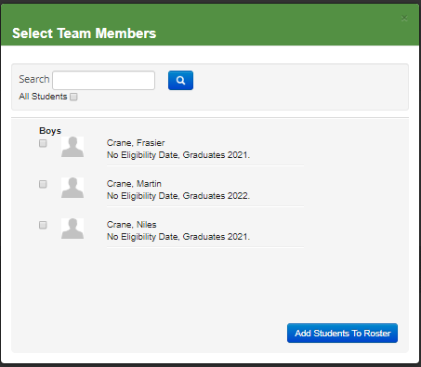
Edit Team – Roster
Provides the ability to add students to a specific team for a specific school year
Students’ teams will not carry over from year to year; addition of students to teams must be completed annually
Select ‘+ Add Players’ button on the right side in order to add students to that team
May select multiple students at one time
Select ‘All Students’ so that a female may be added to a male team

Slide 27
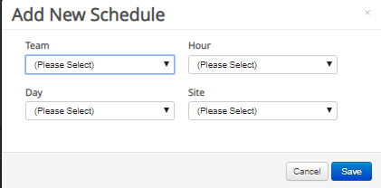
Edit Team – Smart Scheduler
Select the green ‘Add New’ button on the right side
Team: Select the additional team that will need a game created
Day: Select the day on which the additional game will need to take place
Can be selected for 10 days before to 10 days after
Hour: Select the hour in which the additional game will take place
Can be selected for 12 hours before to 12 hours after the hour in which the original contest took place
Site: Select whether the additional game will take place at the same site or if the sites will swap home and away (i.e. Varsity at home while J.V. is away)

Slide 28
Opponents
Landing page will list each opponent that is or has been scheduled
May have as many or as few as needed
Opponent must be listed in order to create an event with that school
Add a new opponent by selecting the green ‘+ Add Opponents’ button

Slide 29
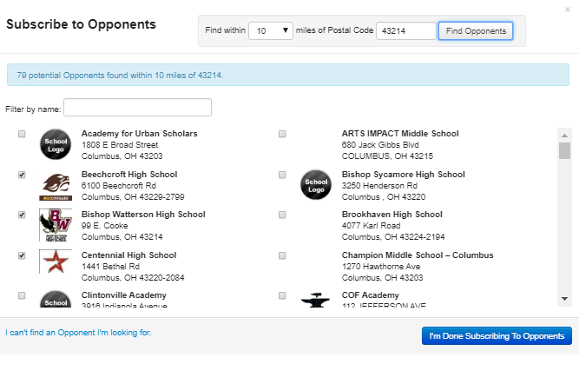
Opponents – Edit List of Opponents
Search using mile radius of a specific zip code
i.e., Find within 10 miles of Postal Code 43214
May select as many opponents as needed by using check boxes
May also find out of state opponents
Look for accounts with logos as that is indicative of an active account
Use the ‘I can’t find an Opponent I’m looking for’ link to add a team that is not listed (mostly used with out of state opponents)
*Opponents are removed by unchecking the box through the same screen*

Slide 30
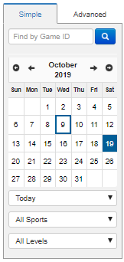
Schedule
Main landing page after logging into the school account
Will initially show that day’s events
Use the calendar to select different dates to view
White indicates no events scheduled; blue indicates events are occurring on that date
Filter options are directly below the calendar to view events in a different fashion
May used advanced filter to create filter options that may be needed (i.e., unaccepted contracts, official issues, transportation issues, etc.)
See next slide for full overview of the tab

Slide 31
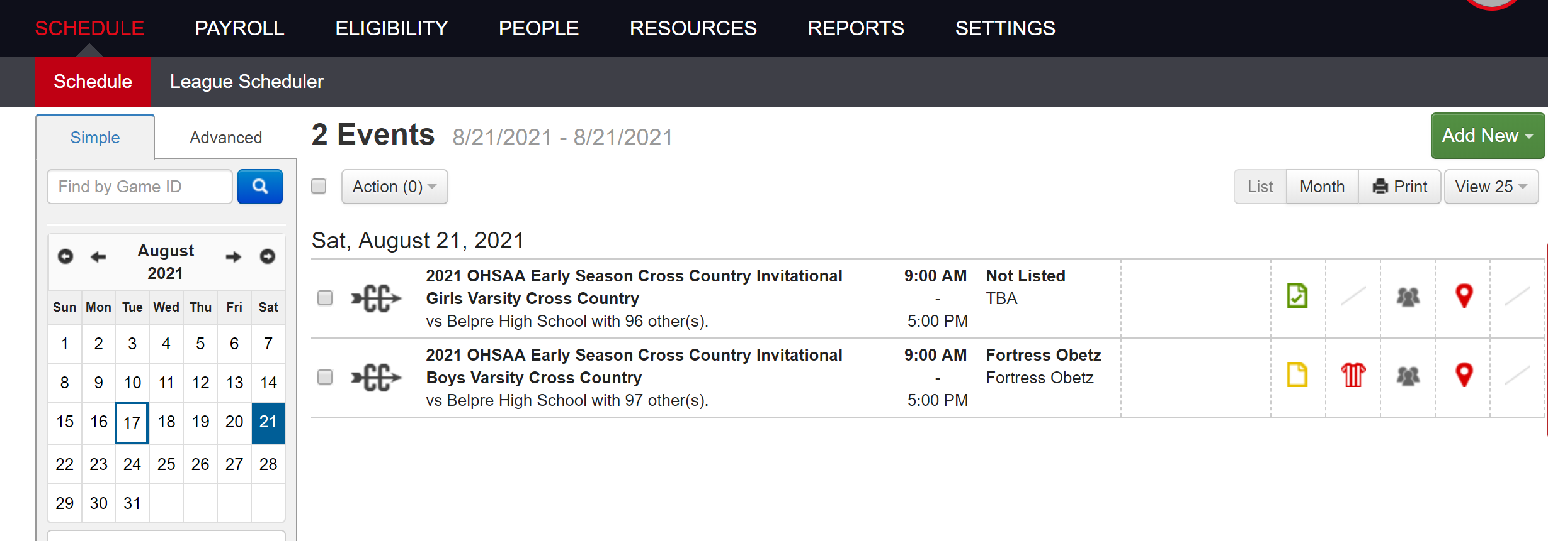
Schedule

Slide 32
Schedule – Events Summary
Events on the front page have 4 sections to the right of the event
Contract, Officials, Event Workers, Facilities and Transportation
Red means action is required of you; yellow means action is required of another party; green means all is well
Click on each icon to view a quick overview of the sections

Slide 33
Schedule – Contract Section
Overview includes the contract addendum, participation fee, breach fee, notes, opponent contact information and status of the contract
Contract may be downloaded by selecting ‘View Contract’ link at bottom left portion of the overview
Contracts can be accepted using the overview
Button to do so will appear on right side of the overview

Slide 34
Schedule – Officials Section
Overview will show the name, payment amount and confirmation dates of the officials assigned
Yellow = officials assigned but not accepted; Red = officials not assigned at all
Full information will not show until the officials accept
Voucher for officials may be printed by selecting ‘Print Voucher’
May be printed with the officials’ full SSN; recommend that it is printed without unless it is absolutely needed
Upper portion of overview indicates who the officials were assigned by

Slide 35
Schedule – Officials Section
Yellow Jersey
Red Jersey

Slide 36
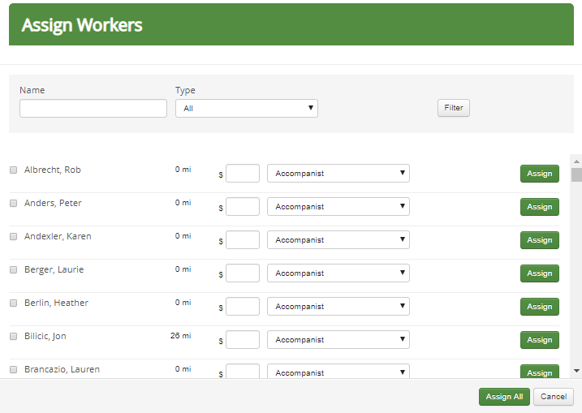
Schedule – Event Workers Section
Event workers may be added quickly by using the ‘Add Event Workers’ link on the bottom left corner
Select the name of the worker, input the fee, select their role for the contest from the drop down and click assign
Those that are assigned will receive email notification regarding the assignment

Slide 37
Schedule – Event Workers Section
Adding event workers allows for custom payment amount and assigning of roles for those specific workers
Use the checkbox to the left of the name to select the workers and the drop down to assign the role
Click the green ‘Assign All’ button to assign those that you have selected

Slide 38
Schedule – Facilities Section
If Arbiter is being used for facilities, this section provides quick view regarding approval and requests for facilities
Can mark requests approved directly in the overview
Facilities will typically appear in red when both genders are competing at the same time at the same event (i.e., track meets, cross country meets)

Slide 39
Schedule – Transportation Section
Similar to the facilities section, this overview will show whether or not requests for transportation have been sent and approved
Requests can be approved directly in drop down

Slide 40
Schedule – New Game
To begin the process of adding a new game, use the green ‘Add New’ drop down to select ‘New Game’

Slide 41
Schedule – New Game
New Game is used for 1 v 1 contests; your school v another school
The landing page of New Game is where information will be input regarding the game
Title
Not a necessity, but may be input if it is a special event
Match-Up:
Use the drop down to select the team you are creating a game for
Use the second drop down to select the school yours will be competing against
The ‘Cross Level’ button allows you to have teams compete that may be different levels
i.e. your freshman team v their J.V. team

Slide 42
Schedule – New Game (cont.)
Where
Site at which the contest will take place
Can also select home or away, but typically will be home as most prefer to schedule their own home games
When
Date, time and duration of the contest being created
Info
Allows for the indication of whether or not the game will be published to ArbiterLive for the public’s use
Game type indicates just that; typically, will be league, non-league or scrimmage
Postseason will only be used when the OHSAA/DABs input contests

Slide 43
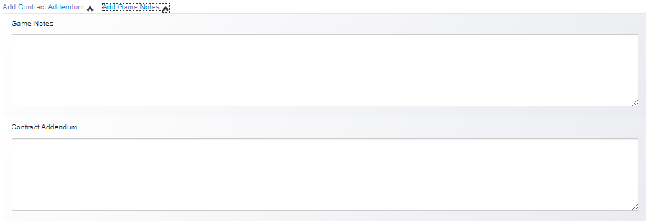
Schedule – New Game (cont.)
Add Contract Addendum
The addition of any type of information that needs to be legally binding
Recommend putting any types of yearly agreements within this section
Add Game Notes
Odds and ends regarding the contest can be placed here
i.e., Lunch is being provided, no coolers on the track, where busses need to park, etc.
Facility Request
Mark the set up and clean up time for the contest
Does not need to be required; may unclick the checkbox
Mark whether the request has been communicated and approved

Slide 44
Schedule – New Game (cont.)
Transportation Request
Like facilities, this is not required
Can select the dismissal time, departure time, number of vehicles needed, and the type of return trip needed from the driver(s)
Mark whether or not the request has been communicated and approved

Slide 45
Schedule – New Game (cont.)
Officials
Use the drop down to select the assignor for that specific contest
If assignor is required, they must be input into that specific team’s page

Slide 46
Schedule – New Game (cont.)
Participation and Breach Fees
Not required and can be unchecked
Recommend placing any participation within the Game Notes as well
Breach fees can be placed into the contest to cover expenses if a contract is broken
NOTE: Even if a breach fee is not put in the contract itself, the OHSAA Office may handle contract disputes and, if a contract is broken, a fine may be levied against the offending school regardless of whether or not a breach fee is present

Slide 47
Schedule – New Game (cont.)
Once each of the fields needed are filled, click either the ‘Create Game’ or ‘Create Game & New’ button a the bottom
‘Create Game & New’ will create that game and open a new window with a near carbon copy of the game just created
Use the page to make small adjustments for the new contest
This allows for quick creation of multiple contests for a single team

Slide 48
Schedule – Add New Options
New Meet
A contest with multiple schools participating that is ranked scoring
Creation is the exact same as New Game, but requires multiple teams be selected
One set of officials typically
New Tournament
Multiple teams competing with bracketed format (i.e. Basketball Holiday Classics, Wrestling Tournaments, etc.)
Requires brackets to be built within the software
If you’re on the fence about whether it should be a meet or tournament, build the event as a meet, and work the brackets outside of Arbiter

Slide 49
Schedule – Add New Options (cont.)
Practice
Can be used to schedule practices throughout the year
Other Event
Used to keep non-athletic events in line
For example, prom, parent-teacher conferences, band concerts, etc. can be placed in the software just so those who schedule events do not double book the multi-activity students

Slide 50
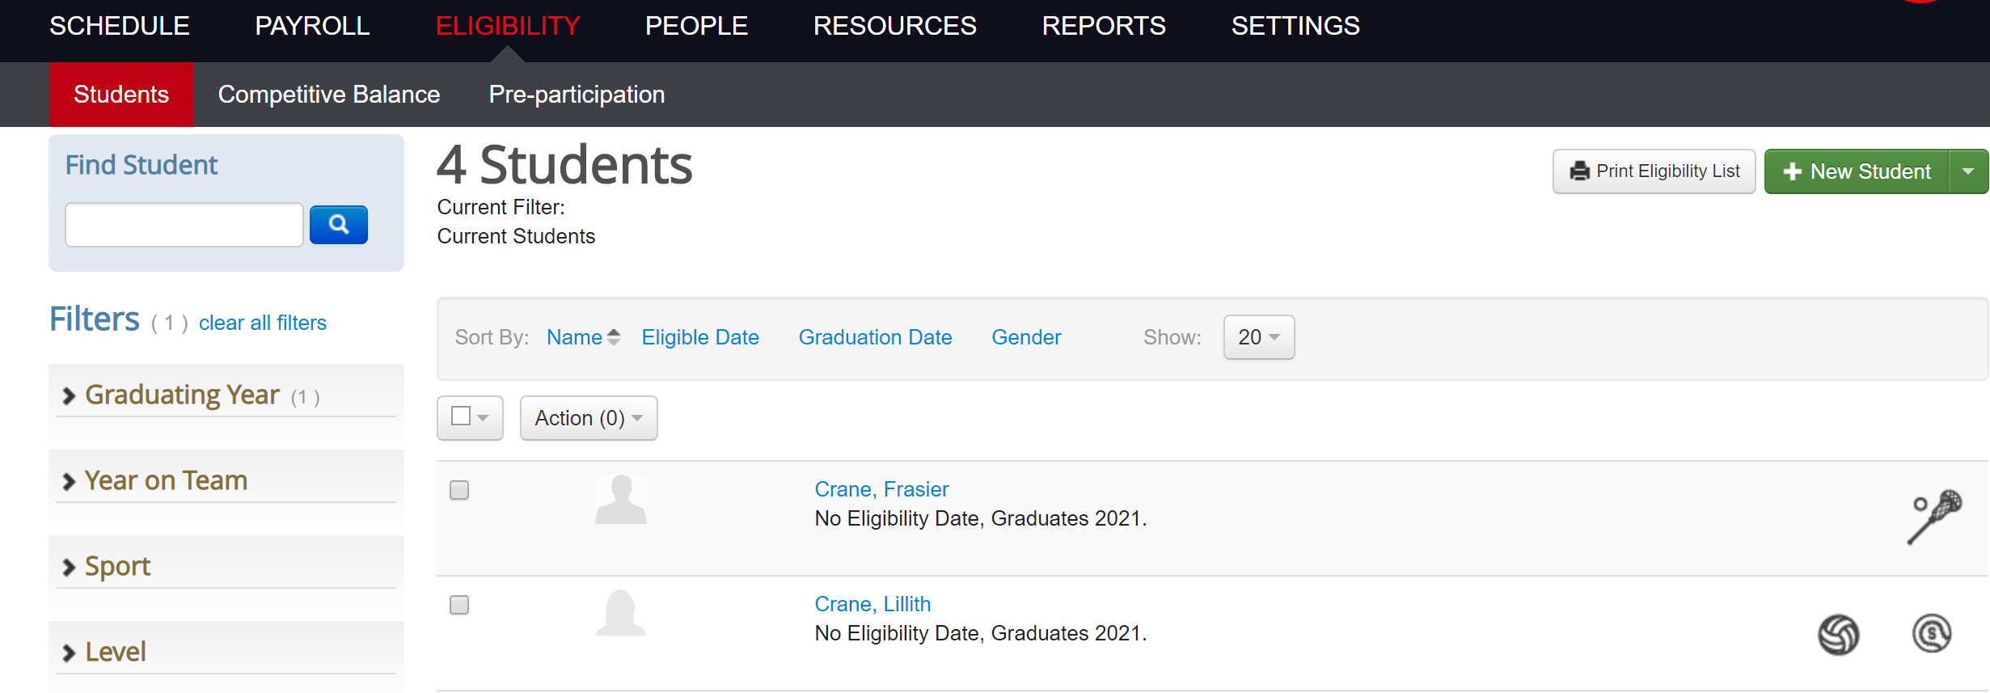
Eligibility - Students
Arbiter allows schools to input students into the system for various functions (eligibility forms, keeping track of medical forms, awards, etc.); the OHSAA’s main function is competitive balance
Landing page will show all of the students within your school’s system

Slide 51
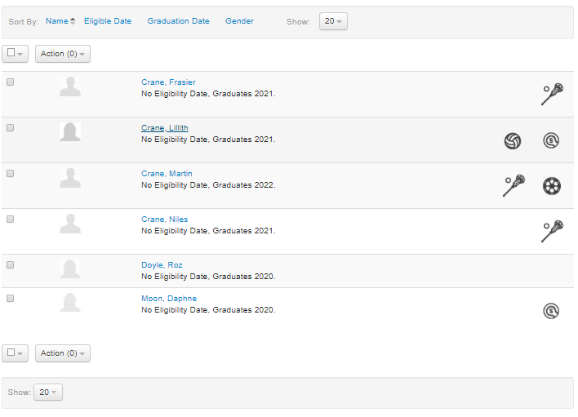
Eligibility - Students
The system will not automatically delete or archive students
A student must be deleted if you want to keep the students tab concise
Filters are available to find specific groups of students
Information present on the landing page includes names, graduation dates, eligibility dates and teams for which that student competes

Slide 52
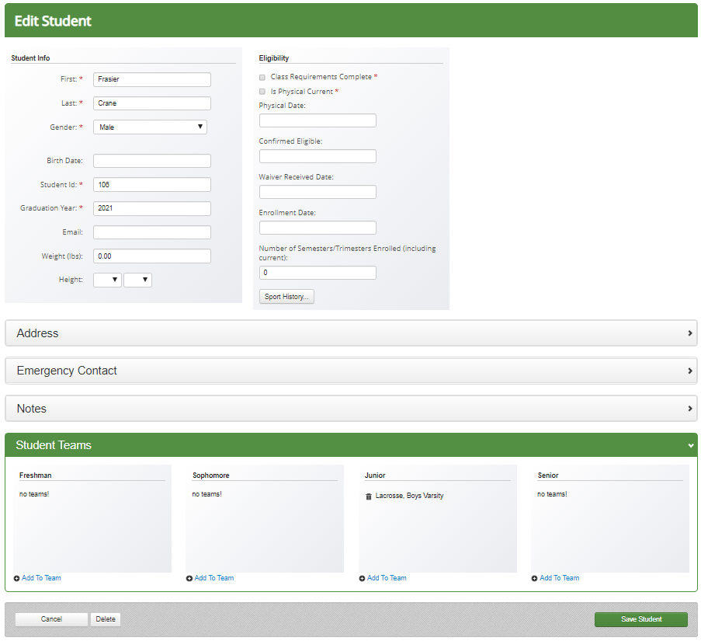
Students – Edit Student
Clicking on a specific student will take you to the ‘Edit Student’ page
Edits can be made to student’s information from this page
Students can be added to teams from this page as well
Use blue ‘Add to Team’ button below the student’s grade level to do so

Slide 53
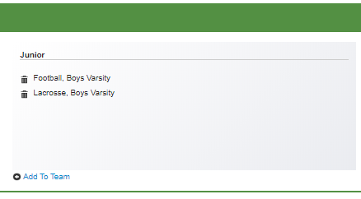
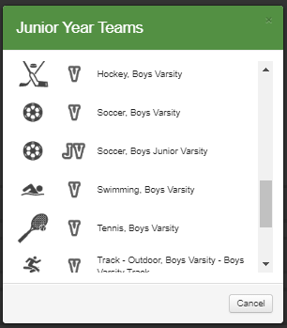
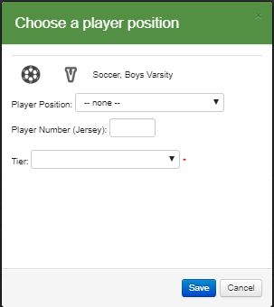
Students – Edit Student (cont.)
To add student to a team, select the ‘Add To Team’ link under the student’s grade level
Select the team for which the student is competing
The pop up will shift and allow for a position and jersey number to be input as well
If the sport is a Competitive Balance Sport, you will be required to input a tier if the entry period for that sport is open
After editing a student, click the green ‘Save Student’ button in the bottom right corner of the page

Slide 54
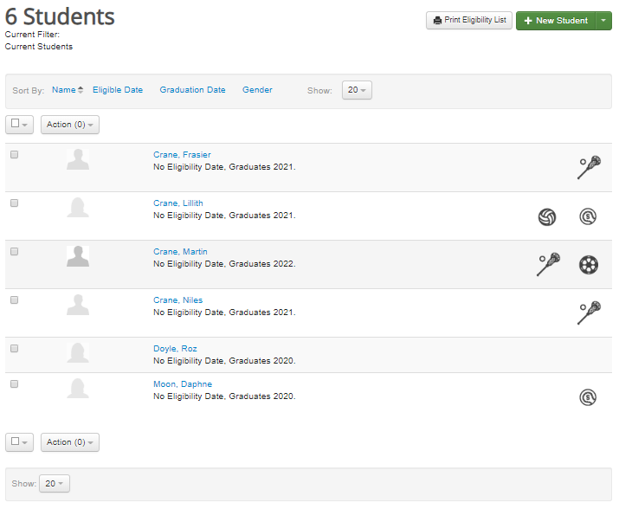
Students – New Student
Students may be added to the system one by one
Click the left portion of the ‘+ New Student’ button in the upper right corner
This will take you to a new page that is exactly the same as the ‘Edit Student’ page
Note: A student must be added to the system before they can be placed on a team

Slide 55
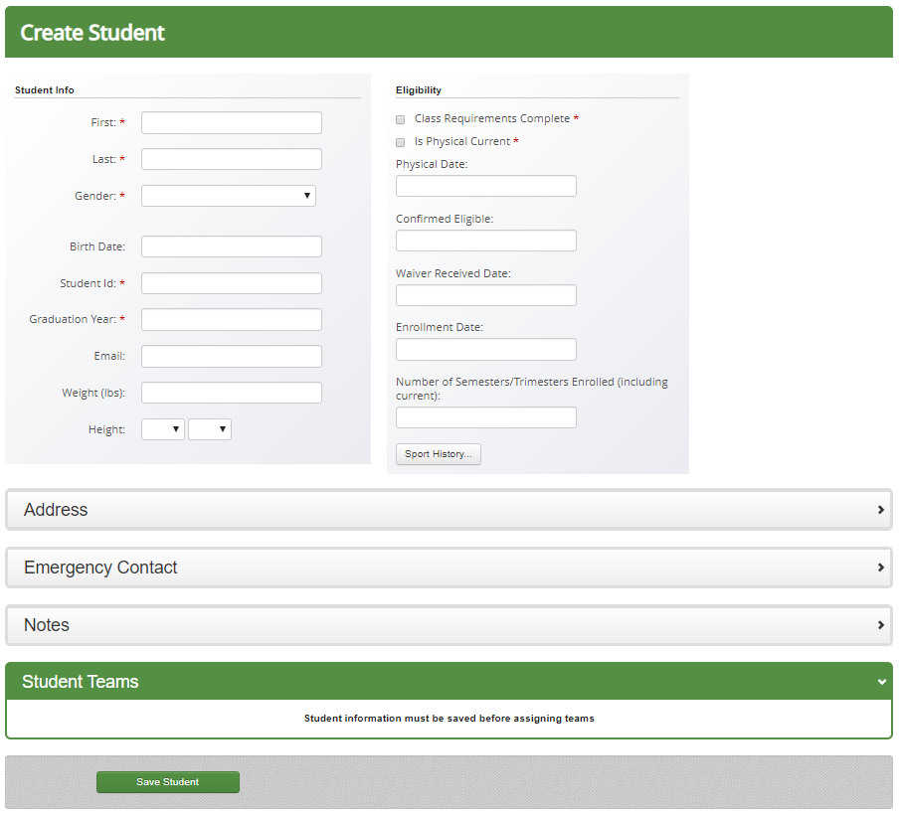
Students – New Student (cont.)
When inputting a single student, 5 fields are required
First name, last name, gender, student ID (typically a number) and graduation year
Student ID must stay the same throughout the student’s tenure to avoid duplicating that student
Additional information may be input depending on the scope of your school’s use of Arbiter
Select ‘Save Student’ when finished

Slide 56
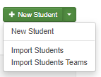
Students – Import Students
Students can also be uploaded in mass if your school has hundreds of new students each year
To begin, select the right portion of the ‘+ New Student’ button and click ‘Import Students’
On the new page, you must download the template provided within the ‘Download Template Button’
Do not make any edits to the top row of the template; this will cause the excel file to not upload correctly

Slide 57
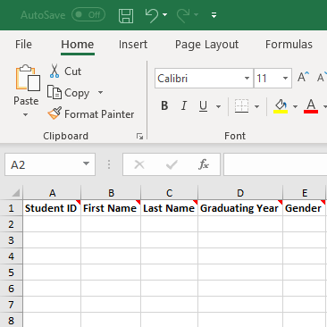
Students – Import Students
The first 5 columns are the only five that must be filled out
The Excel document does have a total of 27 columns, but Student ID, First Name, Last Name, Graduating Year and Gender are the only ones that are required
The Graduating Year must be entered as a single year
2020, 2021, 2022, etc.
NOT 2019-2020, 2020-2021, etc.
Again, DO NOT make any changes to the first row; this will cause the software to reject the upload

Slide 58
Students – Import Students
After the Excel template has been filled out appropriately, save the document to an easily accessible location
Ensure the document is save as a .xls file; any other format will cause Arbiter to decline the upload
Select the ‘Choose File’ button on the ‘Import Students’ page and select the newly saved file
Arbiter will provide a summary of how many students were attempted to be uploaded, how many were successful and how many failed
If any failed, a reason will be provided; simply adjust the Excel file appropriately and try again
Assuming the Student ID numbers stay the same, reuploading the Excel file will not cause students to appear twice

Slide 59
Students – Team Import
To quickly add whole rosters of students to teams, the ‘Import Students Teams’ function can be used
Uses an Excel template similar to ‘Import Students’ tool
As with the previous template, it is imperative that the first row remains unedited when inputting information
Use the ‘Download Template’ button on the ‘Import Students Teams’ page

Slide 60
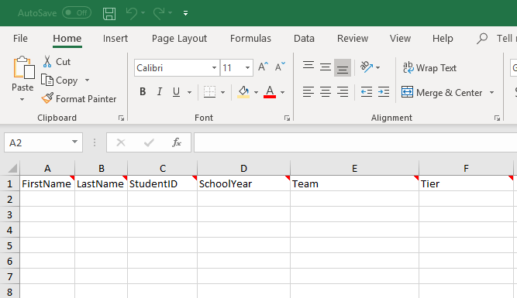
Students – Team Import
When inputting information into the excel document, ensure that the First Name, Last Name and Student ID match the appropriate students
The first 5 columns are required in this template; tier will only be used for those sports that require Competitive Balance information to be provided
Use the drop down menus provided for School Year, Team and Tier

Slide 61
Students – Team Import
After the Excel template has been filled out appropriately, save the document to an easily accessible location
Ensure the document is save as a .xls file; any other format will cause Arbiter to decline the upload
Select the ‘Choose File’ button on the ‘Import Students Teams’ page and select the newly saved file
Arbiter will provide a summary of how many students were attempted to be uploaded, how many were successful and how many failed
If any failed, a reason will be provided; simply adjust the Excel file appropriately and try again
Assuming the Student ID numbers stay the same, reuploading the Excel file will not cause students to appear twice

Slide 62
Eligibility – Competitive Balance
Sports that require Competitive Balance information to be input will appear within the ‘Competitive Balance’ sub-tab of the ‘Students’ tab
Note: Sports will only appear once the Roster Entry Period opens
Information can only be input during the school year in which you are currently operating

Slide 63
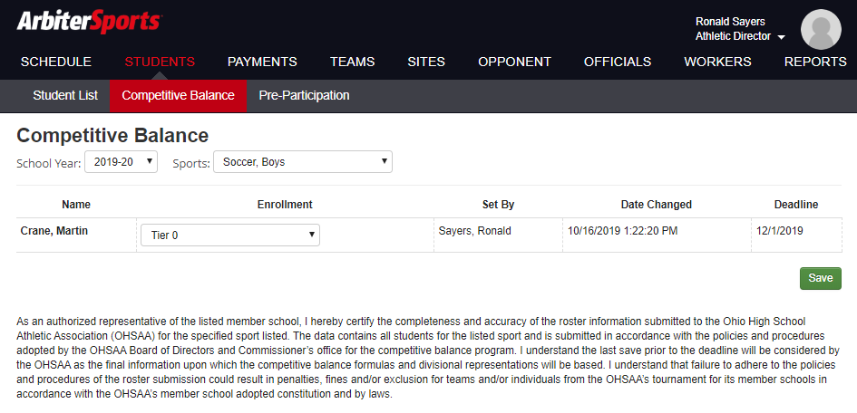
Students – Competitive Balance
Students that are placed onto rosters that require CB information will appear on the ‘Competitive Balance’ screen after selecting that sport from the drop-down menu
If the students were not tiered during the ‘Import Students Teams’ process, they may be assigned their appropriate tier through this page
Select the drop down under enrollment and click the tier the student would be assigned based on the guideline set forth in Bylaw 2-2 of the OHSAA Handbook
Please see the OHSAA’s Competitive Balance Resource Center for more information on how to determine a student’s tier
Select the green ‘Save’ button in the bottom right corner to ensure the information is saved appropriately

Slide 64
Payroll
The ‘Payroll’ tab is associated with the use of ArbiterPay
Schools are not required to use ArbiterPay
Can be used to issue payment to officials and event workers
Speak with ArbiterSports Sales Rep to discuss transaction prices
Studies show that the issuance of paper checks costs upward of $5 per transaction when factoring in cost of materials, postage and work time used
Note: ArbiterPay can only be used to pay individuals who are not contracted through the school in some form or fashion
Individuals are not charged to withdraw their money from Arbiter when they receive payment
ArbiterSports also prepares the 1099 for everyone
To add to the school’s available funds, money is paid directly to ArbiterPay in the form of a check or wire transfer

Slide 65
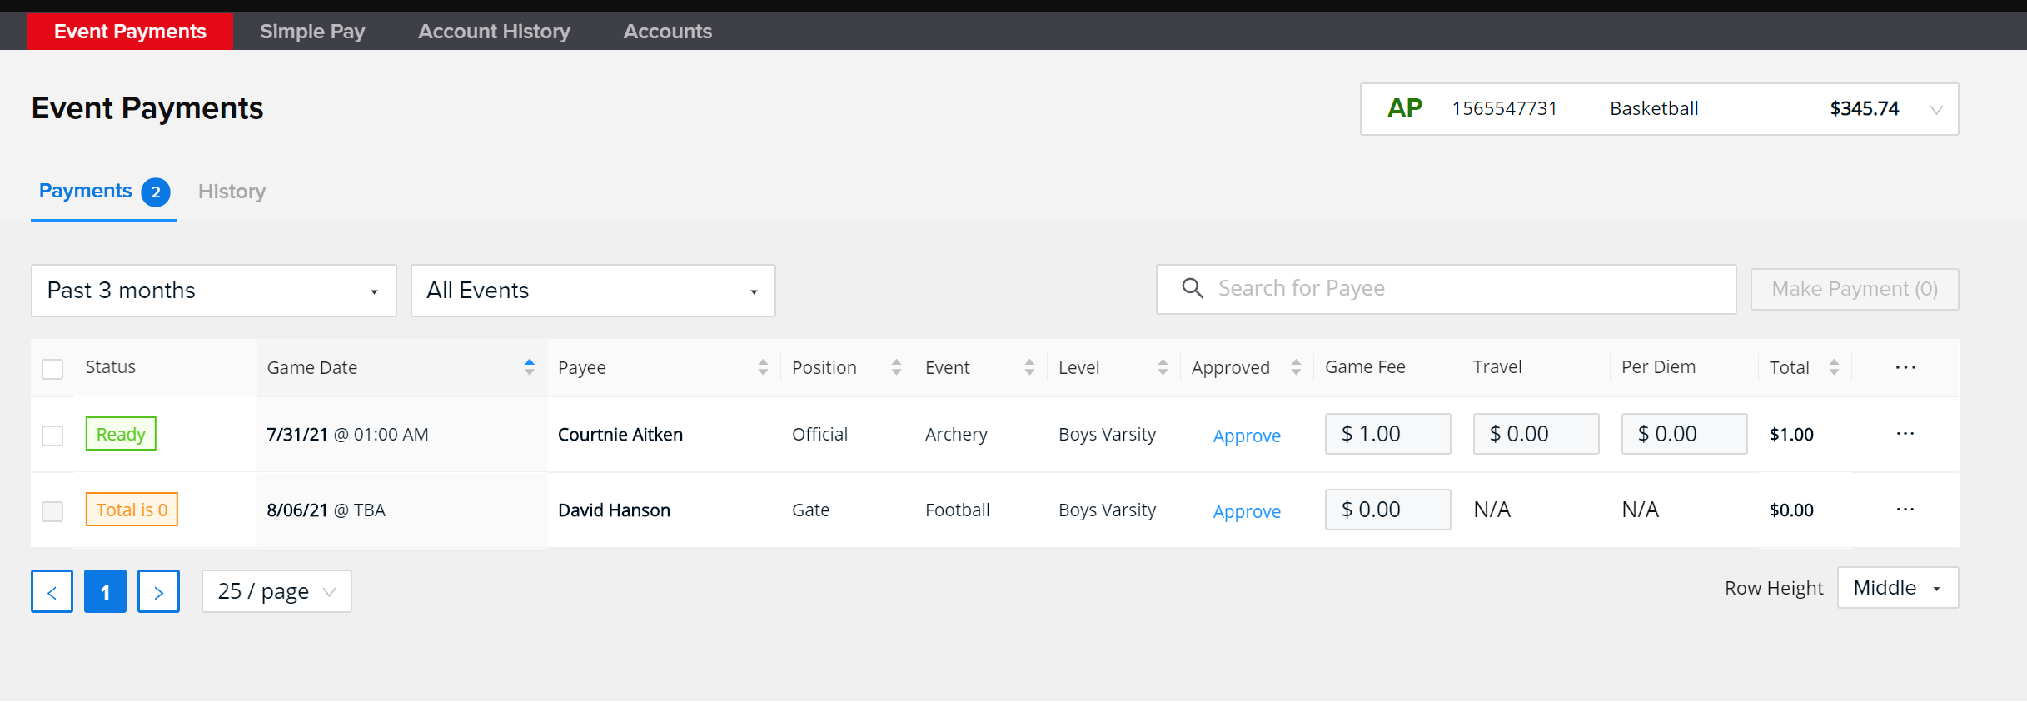
Payroll – Event Payments
To issue payments, select the box next to the individual(s) that need to be paid, and use the ‘Make Payments’ button to the right to complete the transaction
Amounts may be adjusted using the button containing three horizontal lines next to the individual’s name

Slide 66
How to sign up for an AP account
Go Payroll tab and Accounts sub tab. From there you can press activate account. This will take you to sign up page so you can register for your AP account as a paying school.
Once you have registered for an account you will receive a link so you can set up a verification call with our accounting team.
If you haven’t been in direct contact with one of our sales reps, they will reach out to you and discuss what you are trying to accomplish with your ArbiterPay account.
One of our onboarding agents will also reach out to you once your account is created and walk you through your first upload of funds. They will also help you with any questions or training you may need.
Process in total takes a little less than one week.

Slide 67
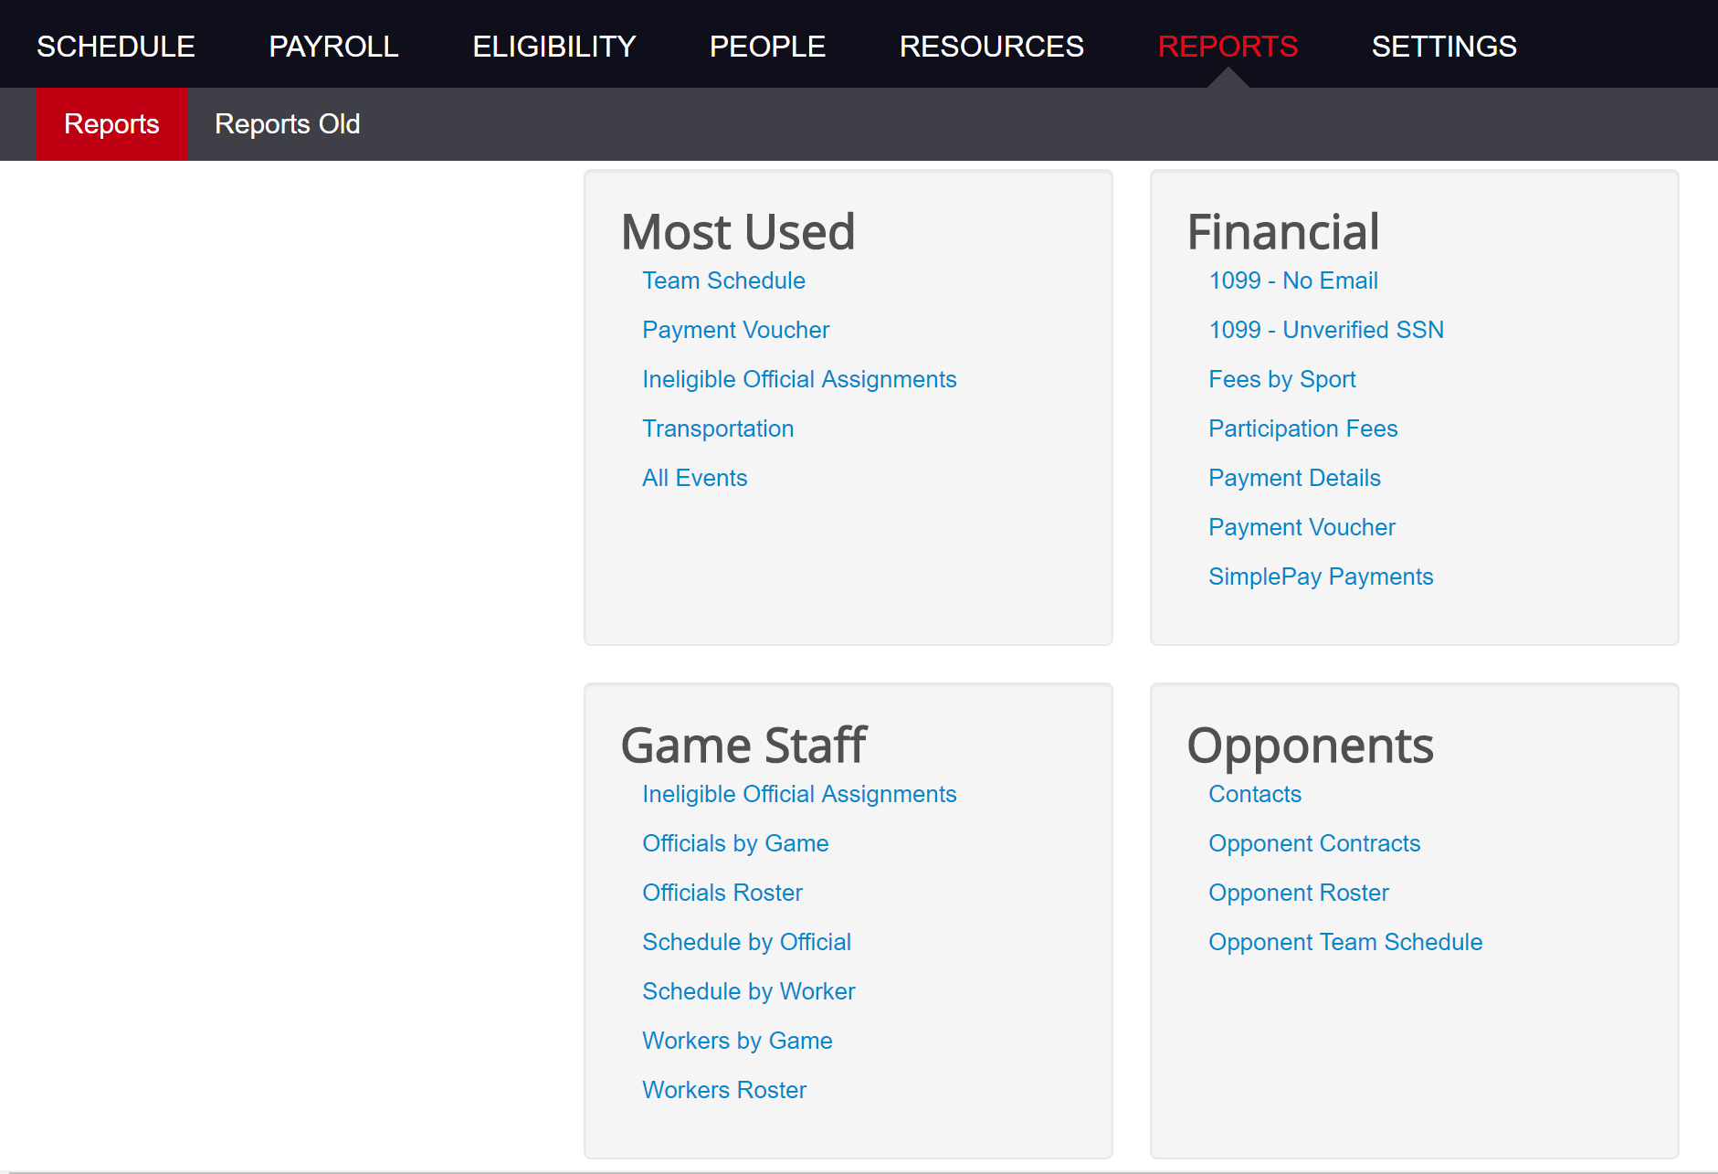
Reports
The ‘Reports’ tab houses a number of different informational items that can be of use
Most used are in relation to transportation, payment vouchers for various individuals, schedules and ineligible official assignments
Most noteworthy is the ‘Ineligible Official Assignments’ report
Shows officials who have been assigned to contests that they may not be permitted to officiate
Using ineligible officials is a liability issue and can result in larger penalties being assessed to the school

Slide 68
Support
Contact information for Arbiter
Technical Support
Telephone: 800-311-4060
Email: Support@ArbiterSports.com
OHSAA Contact Information
Ronald Sayers
Telephone: 614-267-2502 x130
Email: rsayers@ohsaa.org

