Slide 1
OHSAA State Gymnastics Review Session
March 4, 2026

Slide 2
Overview
This PowerPoint contains an overview of the protocols in place for the 2026 OHSAA Gymnastics Tournament.
This PowerPoint is meant as a guide, and not a replacement, of the Tournament Regulations.
This meeting does not replace the in-person coaches meeting that takes place prior to the start of competition on both days.

Slide 3
Welcome and Introductions
Congratulations on advancing to the State Tournament!
Staff:
Hilliard Bradley High School Staff
Carol Eskay
Chad Bobek
OHSAA
Kelly Schoenly
Lori Powers-Basinger
Tim Stried

Slide 4
Schedule
Saturday, March 7 - TEAM COMPETITION
11:00 p.m. - Registration
12:00 p.m. - Doors Open for Spectators/Coaches Meeting
12:30 p.m. - Parade of Competitors/Introduction of Officials
1:00 p.m. - Team Competition Begins
Sunday, March 8 – INDIVIDUAL COMPETITION
9:00 a.m. - Registration
10:00 a.m. - Doors Open for Spectators/Coaches Meeting
10:30 a.m. - Parade of Competitors/Introduction of Officials
11:00 a.m. - Individual Competition Begins

Slide 5
Tickets and Administrative Credentials
All tickets are general admission and may be purchased in advance or onsite via cash or credit card. A QR code will be available at the gate to purchase tickets. Every person who enters the venue must have a ticket.
Doors open to spectators 1 HOUR prior to the start of competition.
Ticket prices:
Adult - $16.00 Student - $10.00
5 and under: Free *Cash or Credit Card
Programs will be sold at the main entrance.
Cost is $5.00 (credit card only)
Administrative Credentials (main entrance):
Each school administrator must scan their administrative ticket and may pick up a floor access credential.
A maximum of THREE (3) will be provided for the principal, athletic administrator and superintendent.
*Athletic Directors, please inform your principal
and superintendent of the process.

Slide 6
Tickets For Alternates or Additional Team Gymnasts
Additional Gymnasts and Alternates
Coaches wishing to bring non-competing gymnasts or alternates must purchase a student ticket on individual day. Only competing athletes can be on the floor on individual day. If an athlete competed on team day and will not be competing on individual day, there will be a pass list at the gate for them to enter for free.
If the gymnast is in the school warmups, a credential for floor access is not required.
We encourage tickets to be purchased in advance but can handle on site.
All athletes and coaches will check in at B10 entrance each day.
If alternates pay to get in and they compete, we reimburse the school/coach.
Athletes competing on Sunday may come and watch on Saturday. Coaches must pick up their packet, and the athletes may sit in the stands.
NOTE: The OHSAA reserves the right to remove gymnasts from the competition floor if the space becomes too crowded.

Slide 7
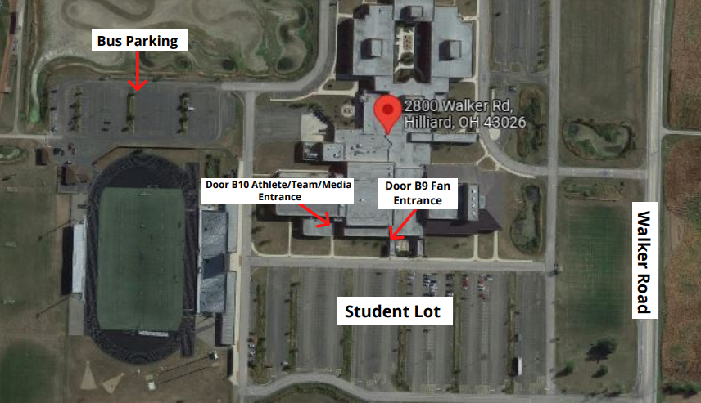
Parking and Entry
Team Bus Parking: Lot next to the football stadium.
Team Entrance: Entrance B10
Coach Packet Pick-Up: Coaches may pick up team and individual qualifier packets in the warmup gym just inside door B10.
Parking: Student Lot indicated on the map. Parking is $5.00 for spectators.
*Each participating school’s athletic director will receive THREE (3) parking passes to distribute to coaches and administrators attending.
Spectators: Spectators enter through B9.
Merchandise: Merchandise will be available for purchase at the main entrance.

Slide 8
Coach and Participant Information
Coach Packets
Team members during team days and those who qualified to compete on individual day will receive a commemorative bag tag.
Coaches will receive credentials based on the following formula:
1-4 competitors: 2 board approved coach passes
5 or more competitors: 3 board approved coach passes
Emergency Contact Forms will be used to confirm coaches – make sure these are updated and submitted.
Administrator Access: Principal, Athletic Administrator, Superintendent, would each receive ONE (1) credential to be in designated administrator area.
Coaches will be provided a credential that will grant access for both days.
Programs will be provided to coaches at the packet pick up location.

Slide 9
Team Starting Assignments
Team Tournament Draw
The OHSAA conducted a pre-tournament draw to indicate the events each qualifying team would start on at the state tournament. Below are the team assignments for Saturday March 7:
Group Rotation | VAULT | BARS | BEAM | FLOOR
A | Kenston | Solon | Magnificat | Olentangy
B | Brecksville Broadview Hgts | Olentangy Orange | Centerville | Anthony Wayne
C | Lakota West | Perrysburg | Strongsville | St. Francis DeSales
REMINDER: Please send Carol Eskay your Team Competition order by the end of the day today.

Slide 10
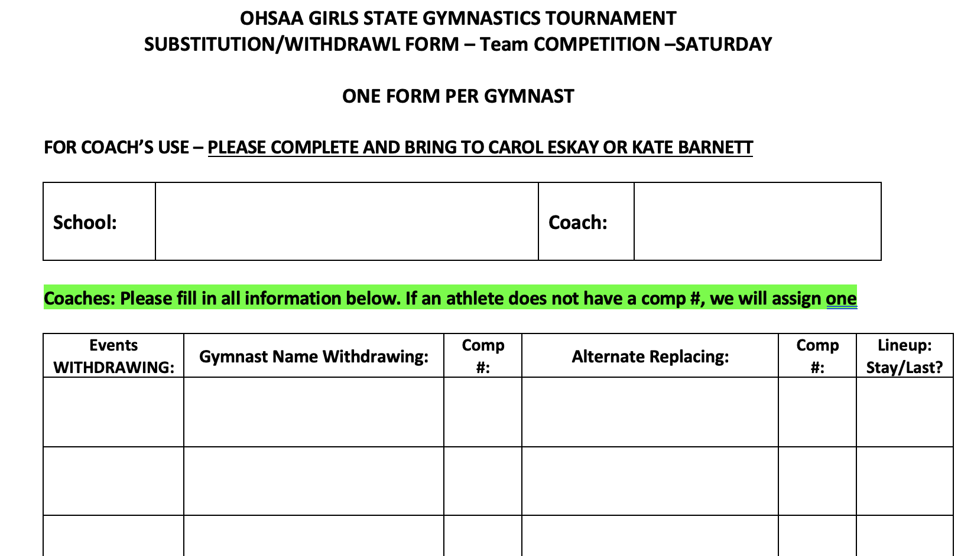
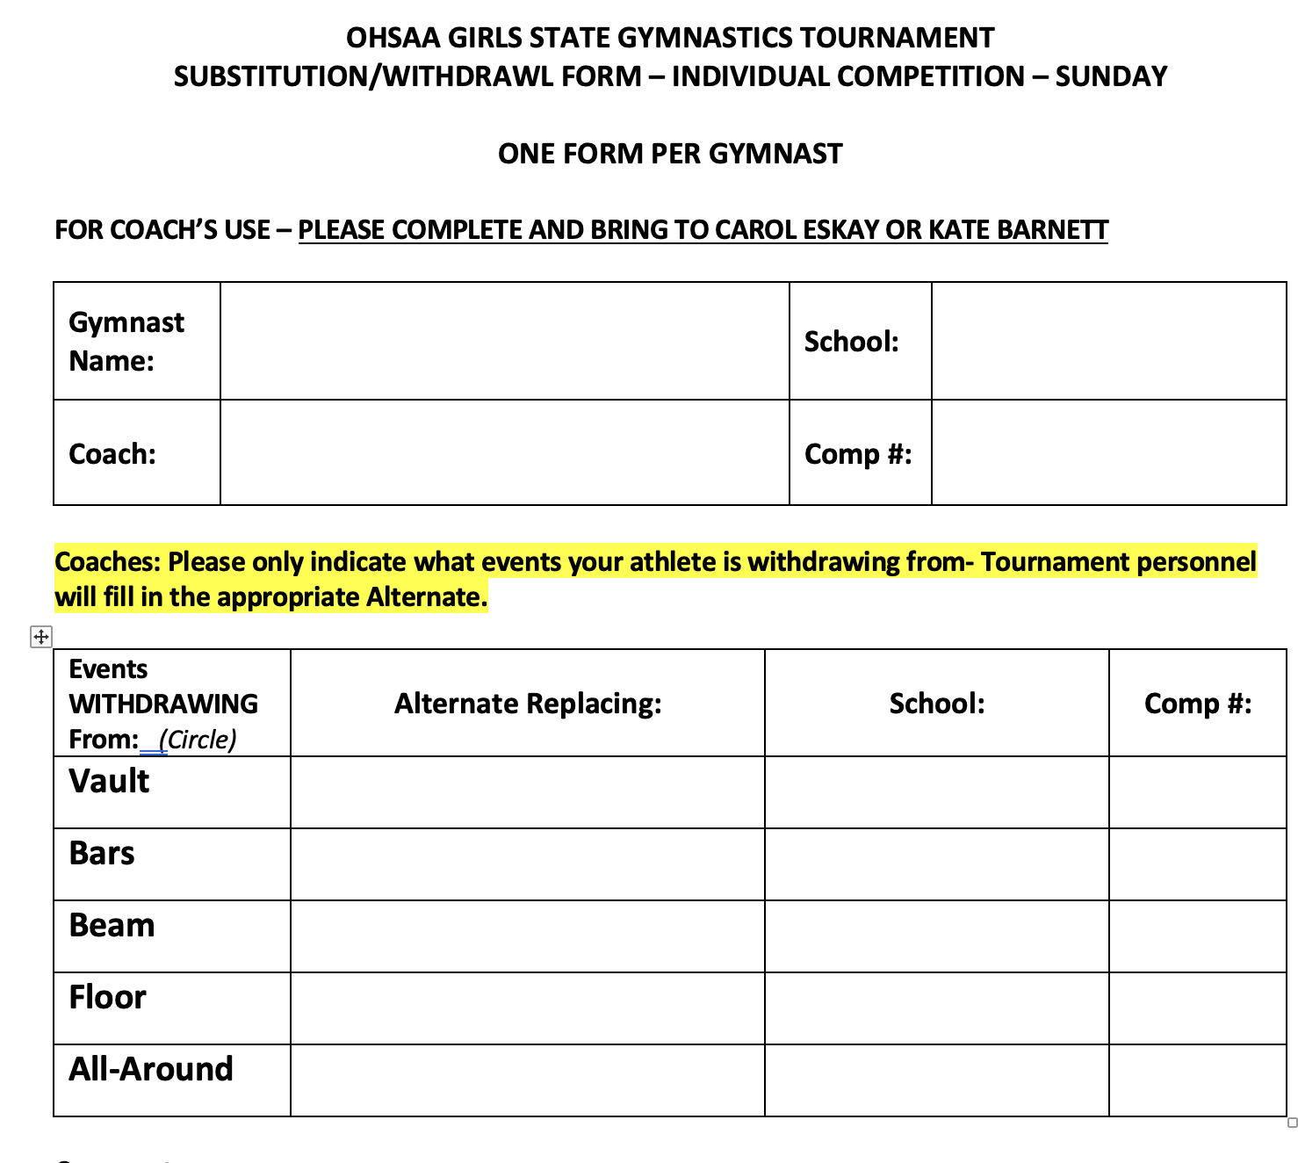
Alternates and Scratches (Overview)
Team Competition (Saturday)
Complete the form to withdraw and athlete (and replace with another if able)
Turn this form into the Tournament Manager- Carol Eskay
When placing an alternate in the lineup, they may only be entered:
In the SAME spot that the gymnast they are replacing was listed – OR-
At the end of the lineup
Individual Competition (Sunday)
Complete the form to withdraw and athlete
Please only indicate which events they are withdrawing from- Tournament staff will complete the portion indicating who will be taking their place (if still able)
We will make all attempts to reasonably include alternates that are available on site.
If you know of a change at Registration- you may turn it in there and they will route it to me

Slide 11
Officiating
Lori Powers-Basinger, Gymnastics Director of Officiating Development
• Open scoring as each judge’s score is flashed
• Refer all questions during competition to the meet referee- please avoid conversation
with the judges
• NO JEWELRY
• Sportsmanlike conduct
• Good luck to all teams and gymnasts!

Slide 12
Warm-Up Procedures
Warm-Ups (Auxiliary Gymnasium and Competition Gymnasium)
No formal warm-up on the competition equipment on either day.
Warm-ups shall take place in the warm-up (auxiliary) gymnasium only, on the identical equipment.
After gymnasts have proceeded to the competition floor and reported to the chief judge for their event, they shall be given their touch warm-up on that equipment (30 sec) and 2/3 vaults.
For the team competition, the time may be “blocked” with the maximum time being three minutes.
Note: The 30 second touch on bars does not include the time needed to set the bars. Download music prior to competition. The internet in the gym may not be reliable
to stream the music.

Slide 13
Additional Information
Event Scoring
Electronic scoring
Back-up / written score
Awards
Upon completion of the final event each day, gymnasts are asked to make their way to the main floor.
Hospitality
Assorted meals, snacks and drinks will be available for coaches, administrators, officials and staff throughout the day.

Slide 14
Key Take Aways…
Teams and individuals enter through B10.
Administrators and spectators enter through B9.
Coaches are required to attend an in-person meeting on site prior to the start of competition.
Team competition order due to Carol Eskay by the end of the day today.
Tickets may be purchased online or onsite via credit card or cash. Non-competing athletes need a ticket.
Please direct fans, parents and members of your community to check out Gymnastics Tournament Coverage page with parking, ticket, etc. information.

Slide 15
Conclusion
Questions?
Safe travels to Columbus this weekend!

